Slide 1
All Things Broadband!
Chesapeake Alliance
June 20, 2023

Slide 2
Today’s Topic!
What’s happening in the 757 with Fiber Infrastructure, Subsea and Broadband?
Attracting Prospective Data Centers: Technology, Talent & Taxes
Community & Economic Development Outreach

Slide 3
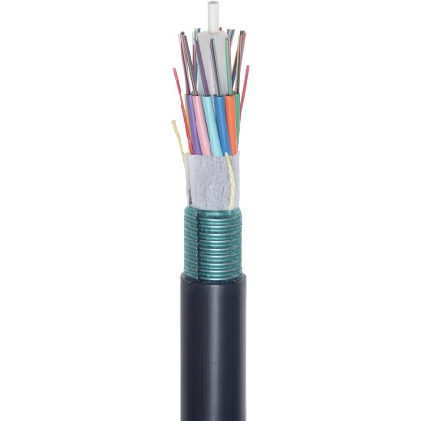
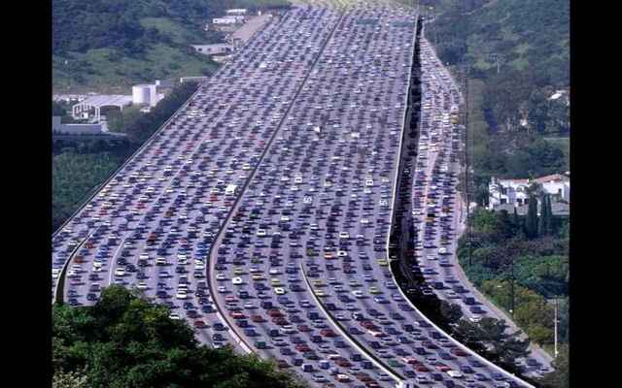
Terrestrial fiber can be both dark fiber and lit fiber
Individual Fiber strands: can be monetized by selling
Dark fiber to customer (lease or IRU), and they connect their own electronics to get the bandwidth capacity they need
Lit capacity or connecting your own electronics and selling lit capacity
Buffer Tube (typically holds 12 fiber strands)
Fiber Cable Sheath (aerial or buried in a conduit)

Slide 4
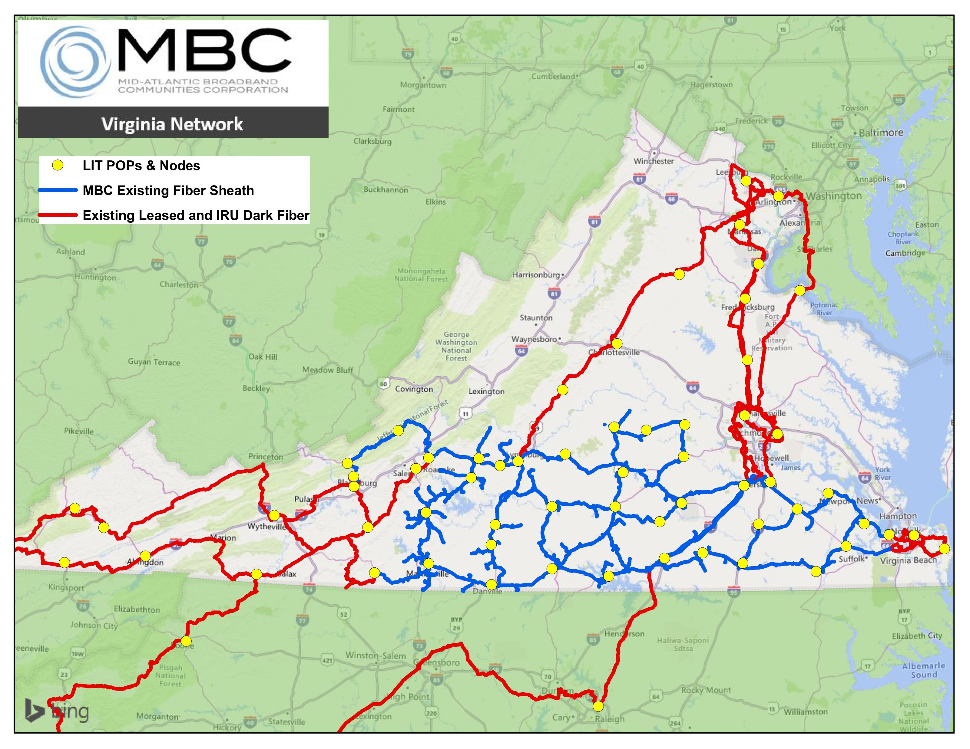
MBC Existing Fiber Network in Virginia
2,000+ route miles owned and operated by MBC
Wholesale, Open-Access Dark Fiber and Optical Transport
60+ carriers and Hyperscale data center customers connected

Slide 5
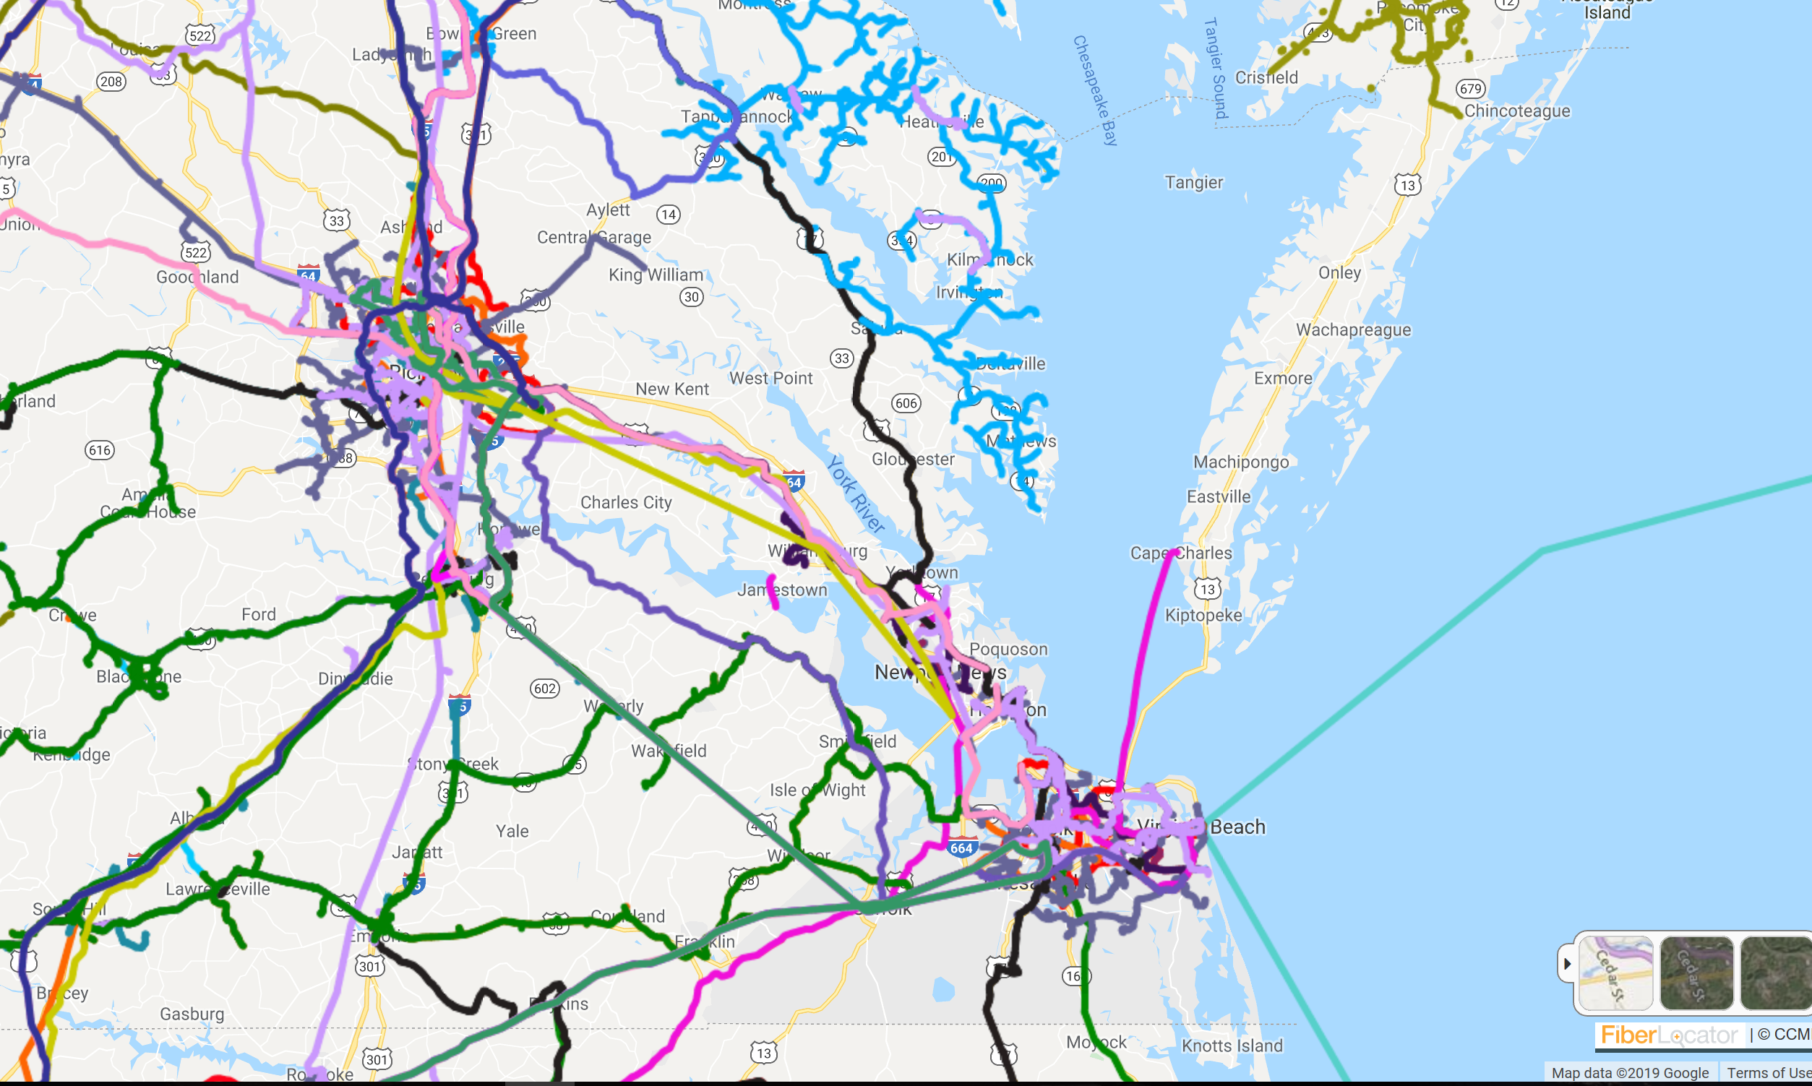
Terrestrial Fiber Cables in the RVA757 Region
Map shows some of the terrestrial fiber cables in place or planned (from 2021)
At least 7 fiber operators have existing facilities between Hampton Roads and Richmond
New or Diverse routes from existing carriers are being considered. CUSTOMERS DRIVE DECISIONS
Richmond: QTS Data Centers & META Data Centers

Slide 6
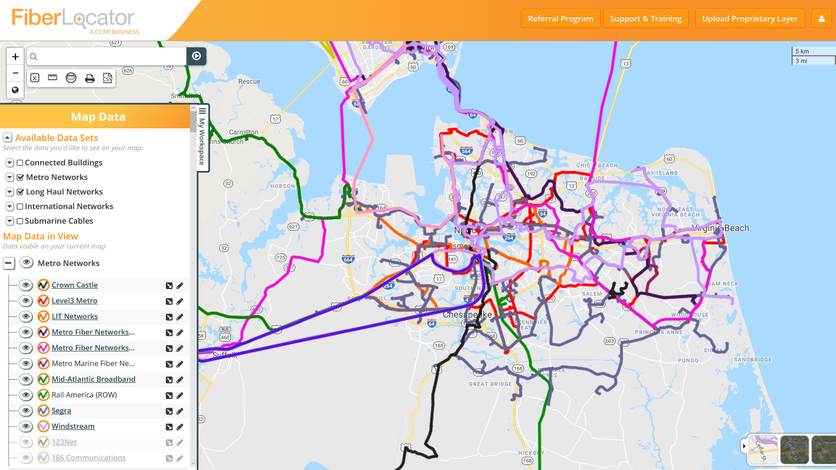

Slide 8
What drives construction of subsea cables?
Scarcity of Capacity and Fiber Pairs
Ownership Economics
Content providers are largest users of bandwidth – lease vs own
Diversity
Physical protection: Routes & Landings
Capacity
Reducing Equipment Cost
Lower unit costs on large systems
(Telegeography, 2023)

Slide 10
Cable Landing Factors
Proximity to Interconnection Hubs (Ashburn, Richmond, Boydton)
Backhaul (existing fiber routes from known providers that connect from cable landing station to network interconnection point
Permitting/Regulatory
Seabed Competition (congestion & rule of 3 water depth spacing)
(Telegeography, 2023)

Slide 11
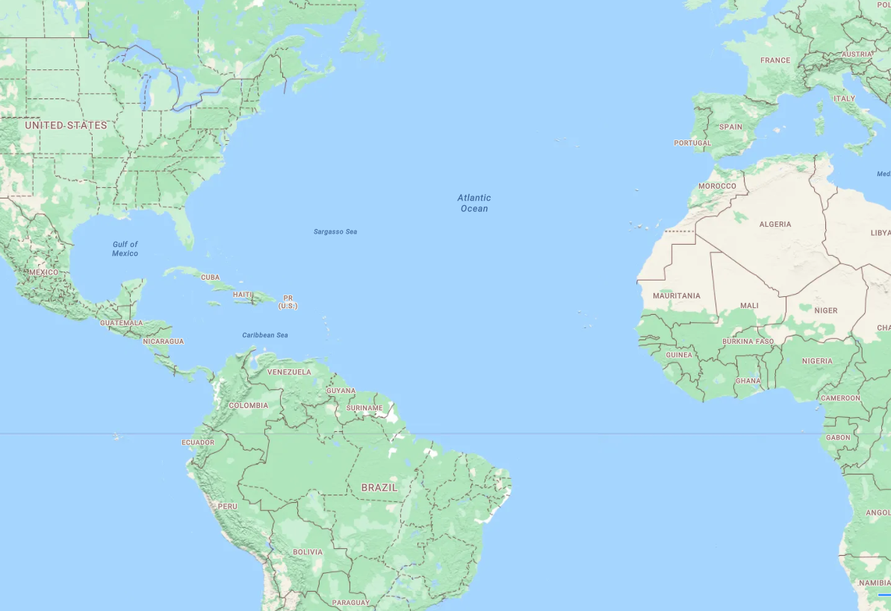
Let the Arms Race Begin!
DUNANT – 250 TB
MAREA – 200 TB
ANJANA – 480 TB
FIRMINA – 260 TB
BRUSA – 160 TB

Slide 13
RVA757 Megaregion: Global Internet Hub
Richmond and Hampton Roads regions: how to grow into a Global Internet Hub to:
Attract Tech Talent
Drive Economic Growth
How to grow more data centers and networks to connect
Steering Committee 3 goals:
Make Inclusive Economic Opportunity a Primary Goal
Serve All communities in the Corridor
Generate Local Jobs and Local Return on Investment

Slide 14
RVA757 Steering Committee
www.globalinternethub.com

Slide 15
Data Center Recruitment
Power, Power, Power!
Local and Regional Economic Development organizations: Inventory and Identify sites
VA Legislature: 2035 state sales tax incentives for data centers expire (sales & use tax exemption, minimum $150M capital, 50 jobs paying 150% of average wage in locality)
Local Taxing Incentives: Personal Property Taxes (i.e. $0.40 per $100 of assessed value)
Existing fiber routes robust and viable for attracting data centers
Climate factors & risks

Slide 16
Our View of Community & Economic Development
BROADBAND

Slide 17
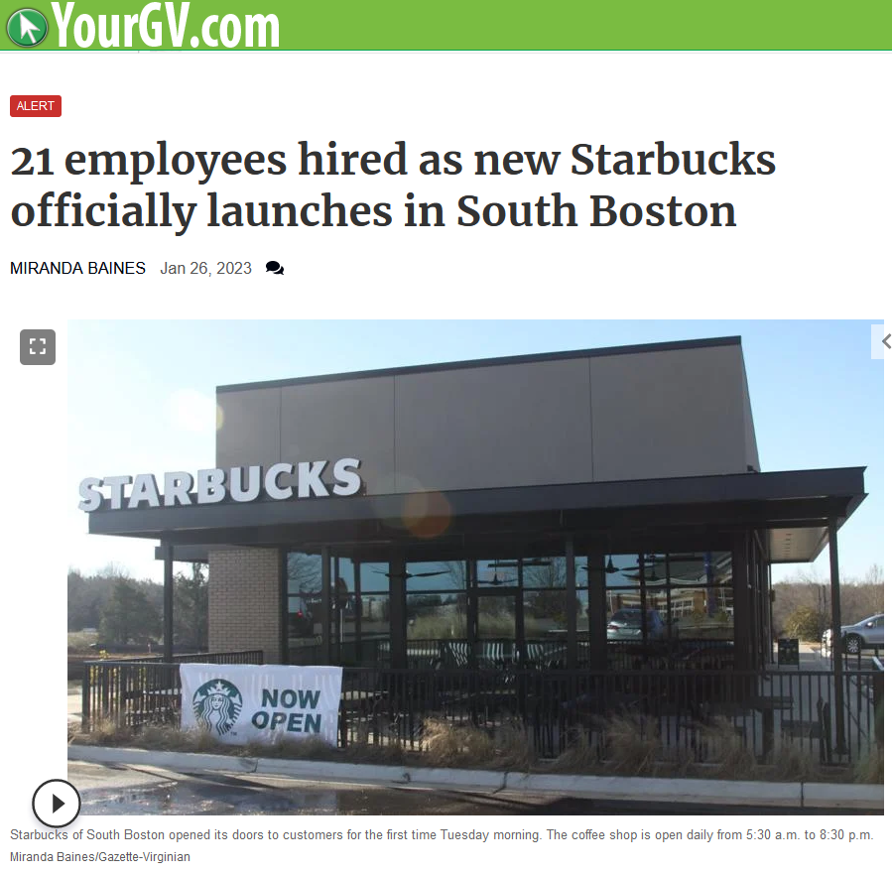
Attracting Tech Talent
One of our core mission area is to Promote Economic Development
We’ve largely solved the broadband infrastructure issue for business … Now What?

Slide 18
https://www.microsoft.com/en-us/nonprofits/digital-inclusion-resources

Slide 19
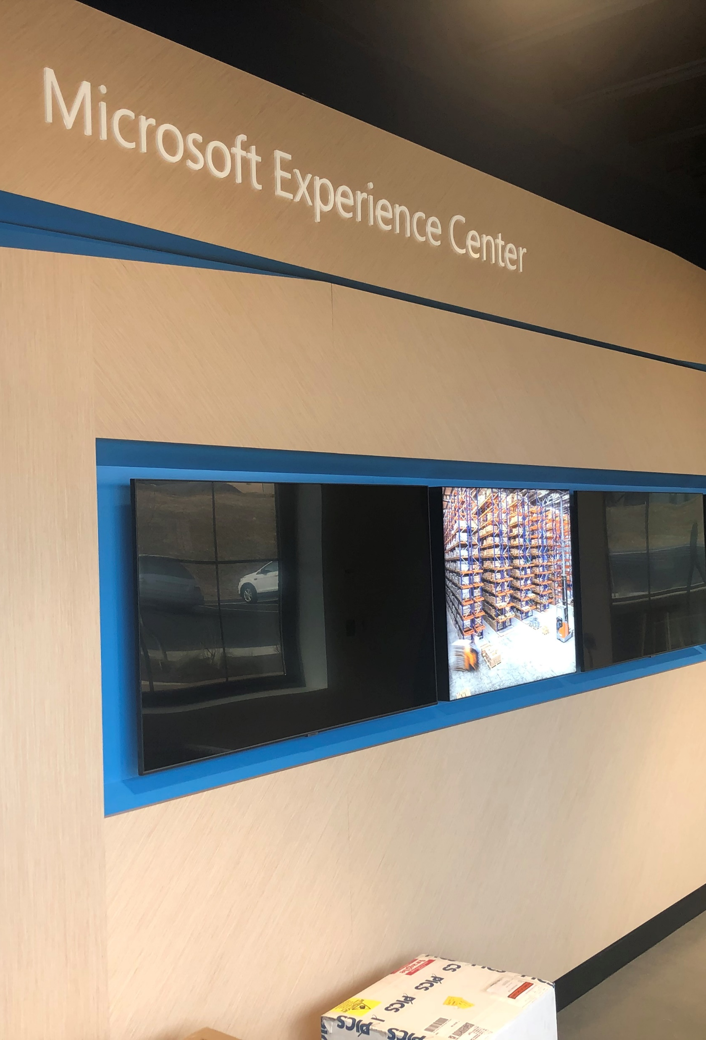
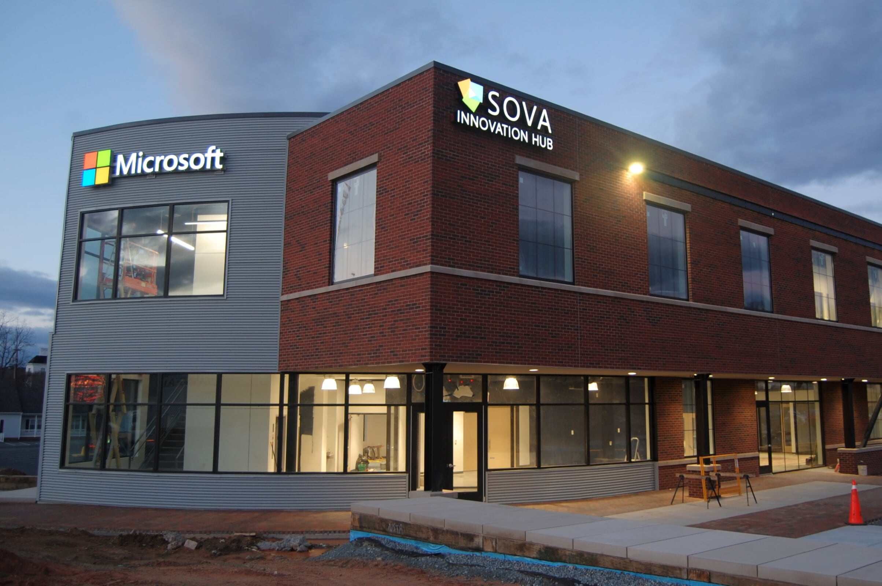
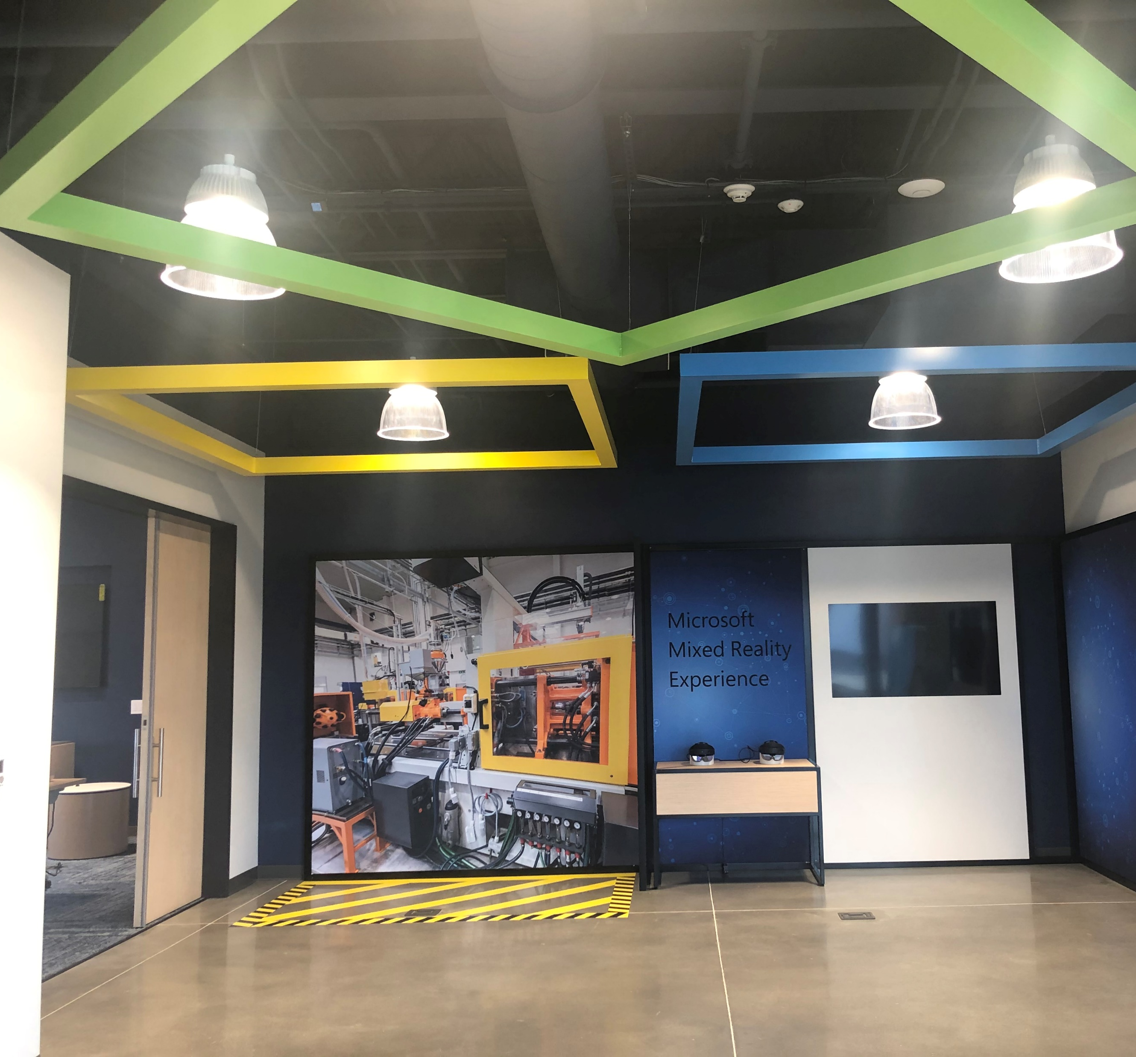
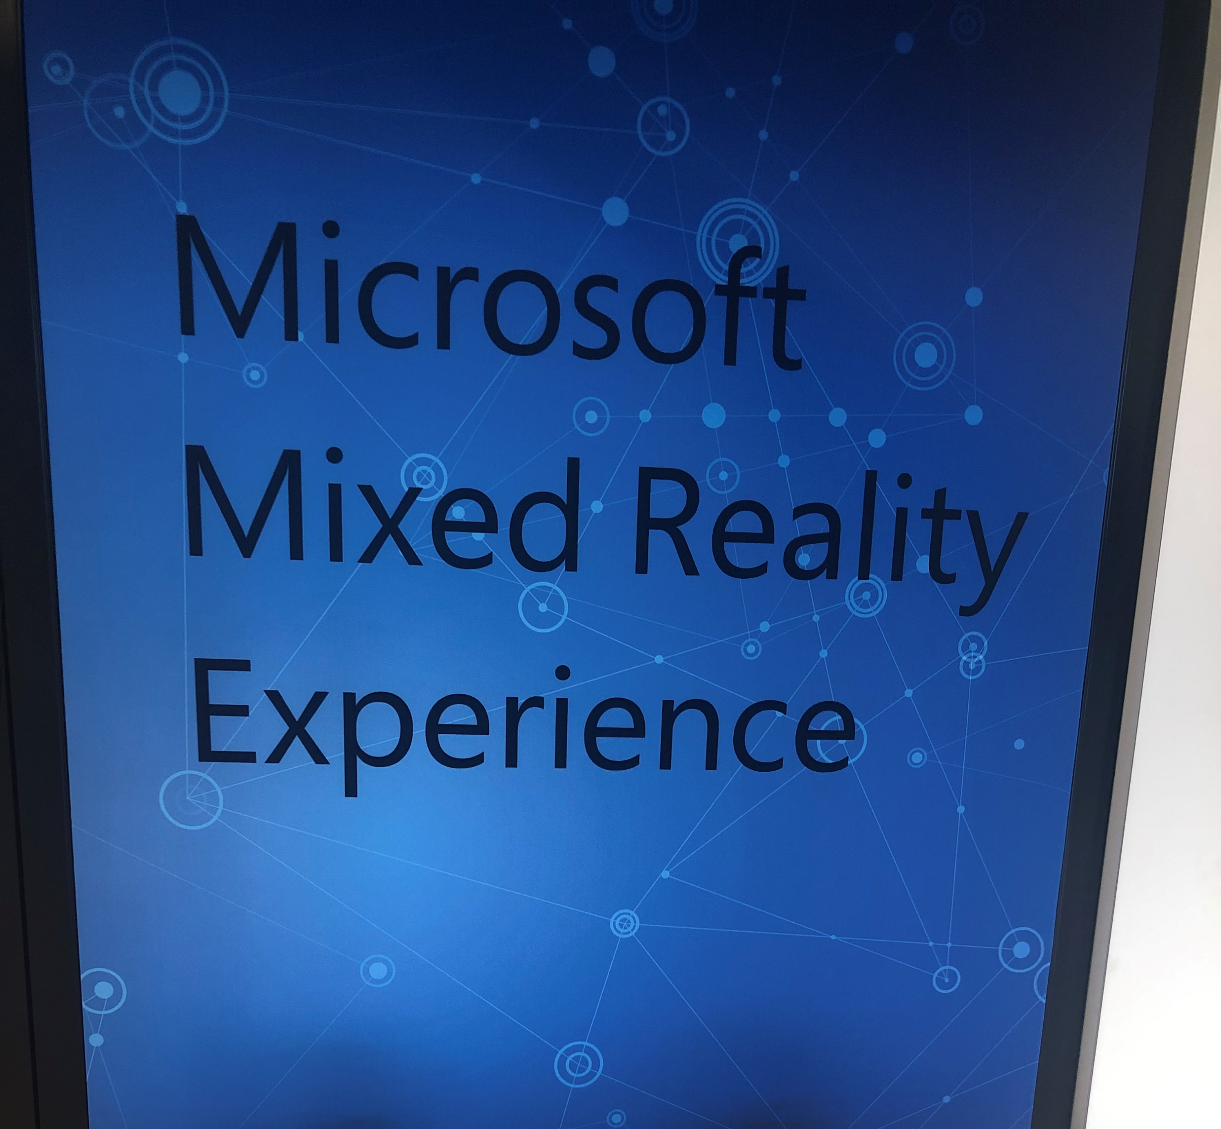
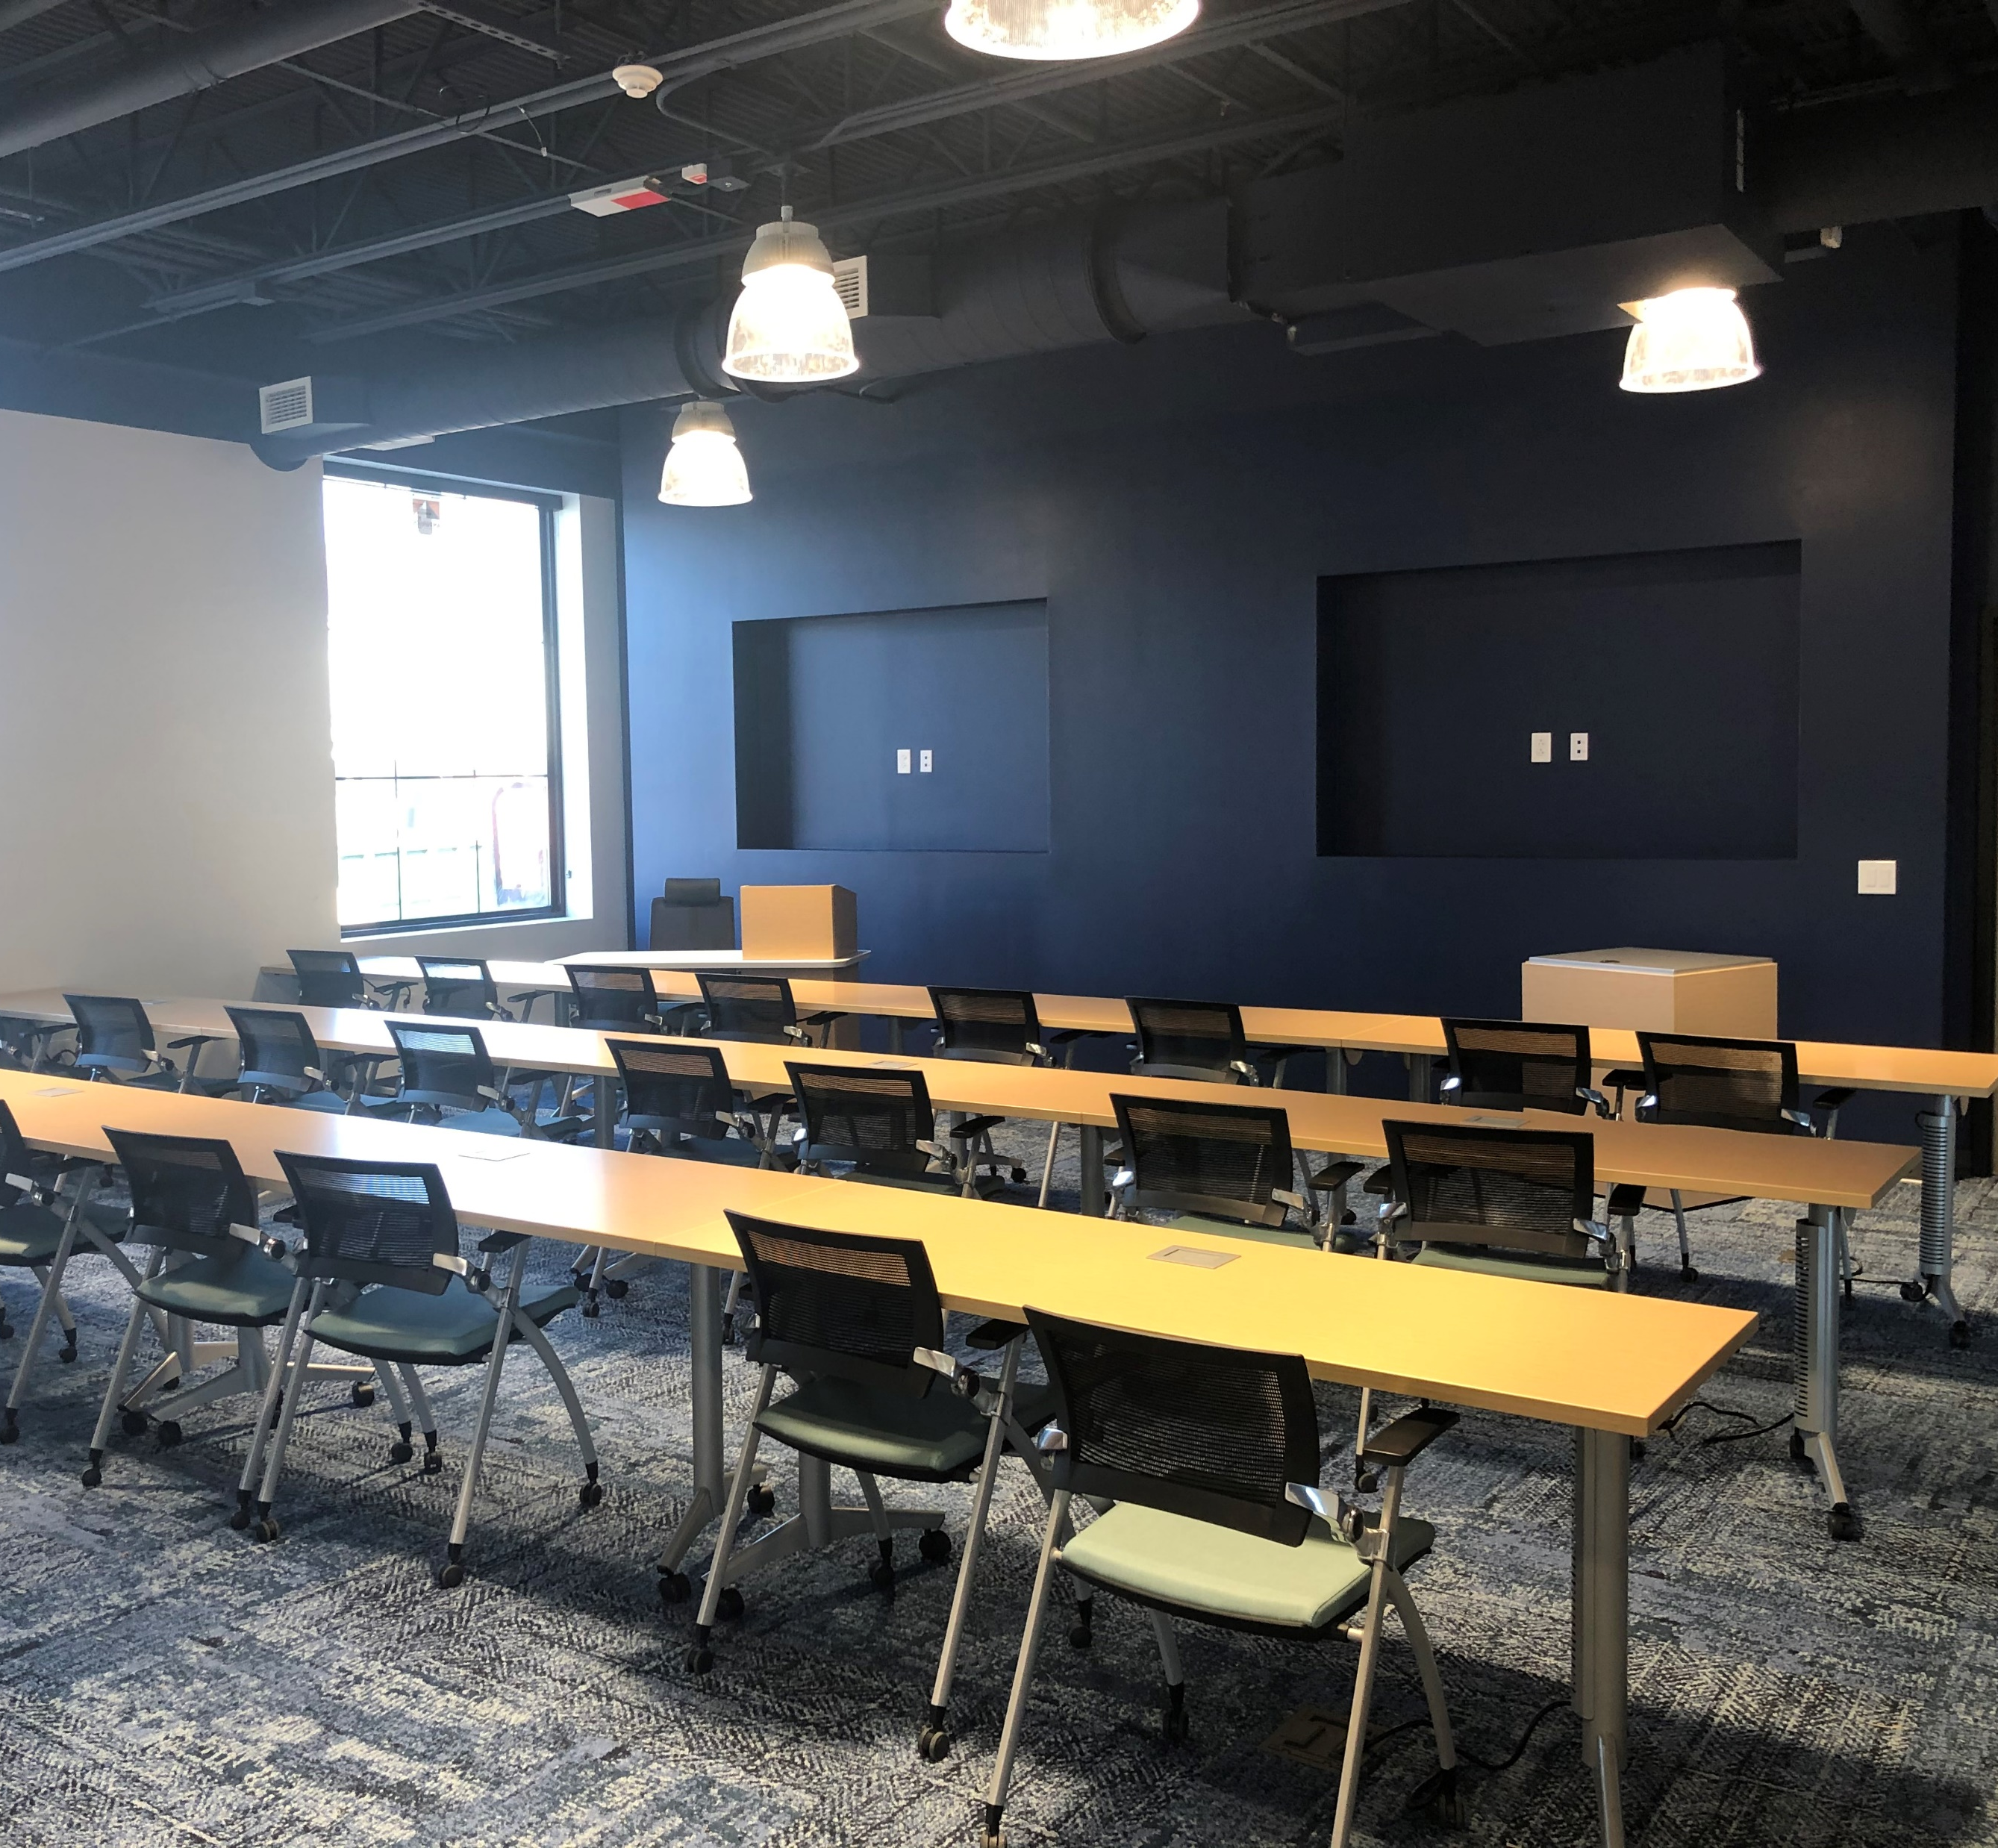

Slide 20
Thank You! Tad Deriso, President & CEO Mid-Atlantic Broadband Communities Corp tad.deriso@mbc-va.com M: 804-855-4057

