Slide 1
Hampton Roads Transportation Projects Update
Robert Crum
Executive Director
HRPDC/HRTPO

Slide 2
Hampton Roads Transportation
Accountability Commission
Sales and Use Tax: 0.7%
Gas Tax: 2.8%
Per the Code of Virginia, monies must be used for transportation projects in our region that provide the highest level of congestion relief for our residents

Slide 3
Key Takeaways
The Hampton Roads region has one of the largest interstate highway construction programs underway in the country
93% of the funding for these projects was generated by the Hampton Roads region through HRTAC
These projects include nearly 200 lane miles of I-64 improvements: the I-64/HRBT, I-64 Peninsula Widening, I-64/264 Interchange and I-64 Southside/High Rise Bridge
Currently, there are federal loans but no federal monies to HRTAC supporting these projects

Slide 4
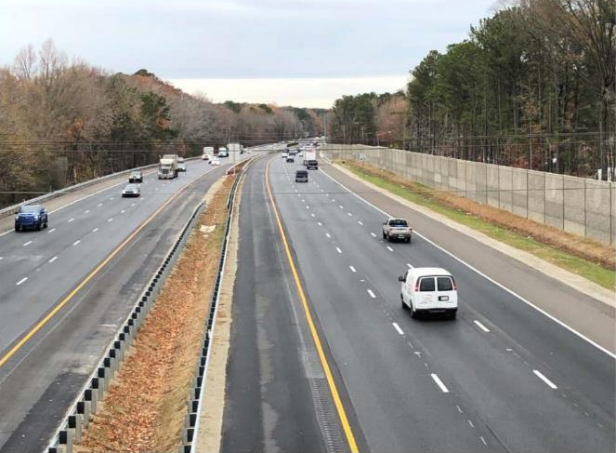
I-64 Peninsula Widening
Segment 1 completed

Slide 5
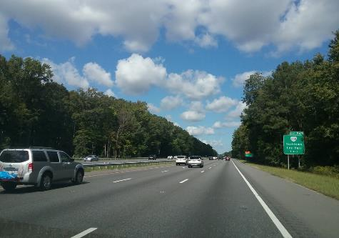
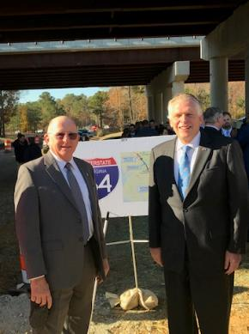
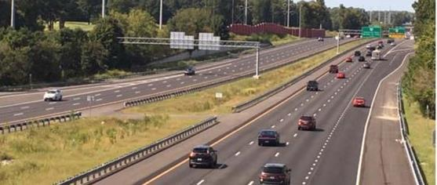
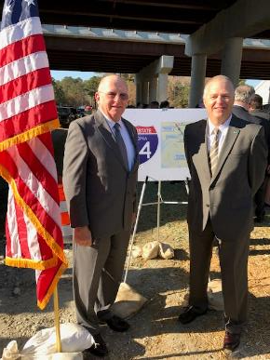
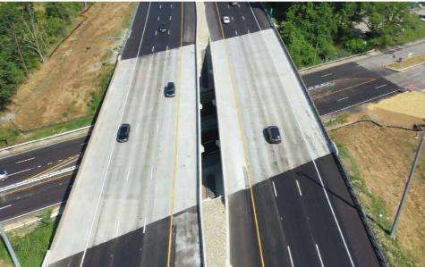
I-64 Peninsula Widening
Segment 2 completed

Slide 6
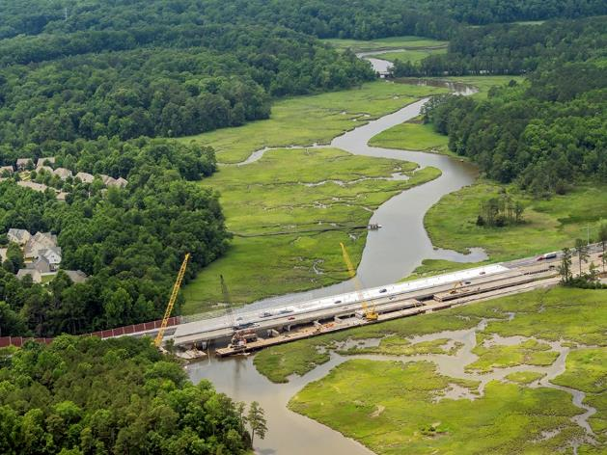
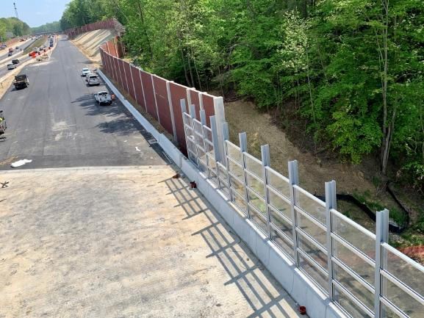
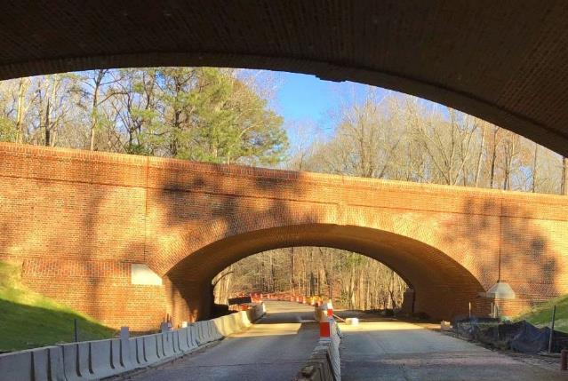
I-64 Peninsula Widening
Segment 3

Slide 7
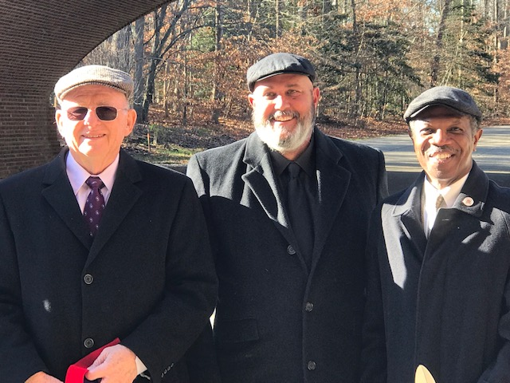
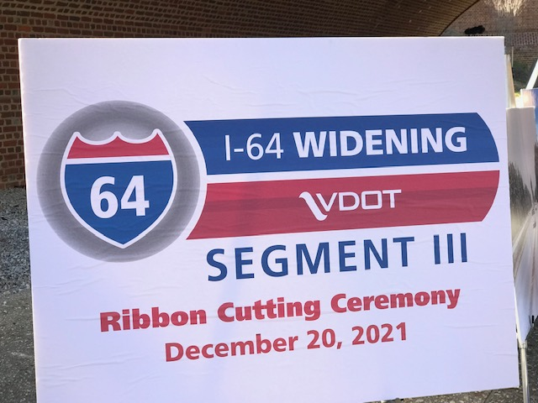
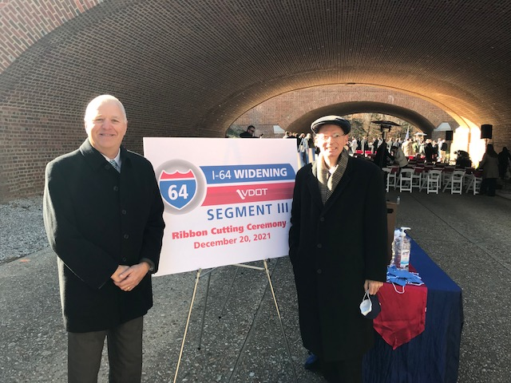

Slide 8
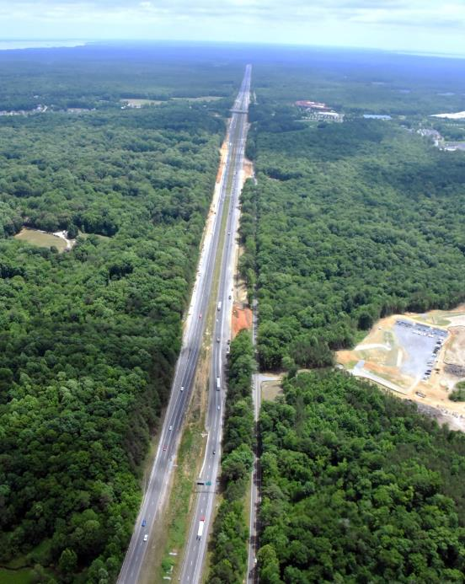
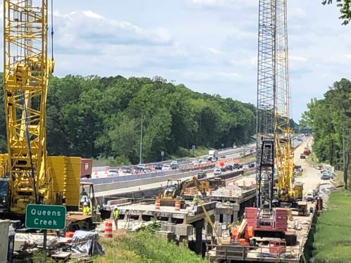
I-64 Gap
Widening of I-64 to six lanes Exit 234 west of Williamsburg eastward
The 29-mile gap lanes remain westward to Bottoms Bridge

Slide 9
I-64 Gap
State Budget Year 1: $300 M
State Budget Year 2: $170 M
$470 M
Federal Funding: $ 25 M
$ 495 M
CVTA $100 M
$595 M
Smart Scale $161 M
$756 M
First 3 phases of I-64 improvements on Peninsula
HRTAC contributed $311 M
29-mile gap from Exit 234 to Exit 205 (9 miles in Hampton Roads)
Total cost of 29-mile gap estimated at just over $750 M

Slide 10
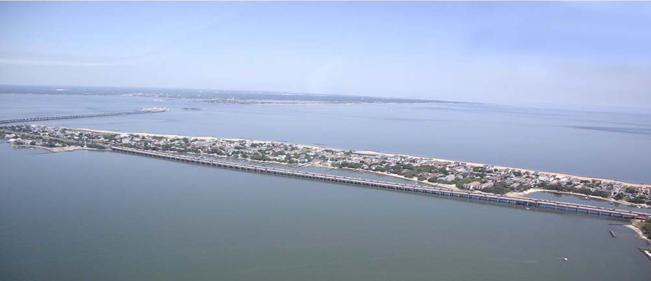
Hampton Roads Bridge Tunnel (HRBT) Expansion

Slide 11
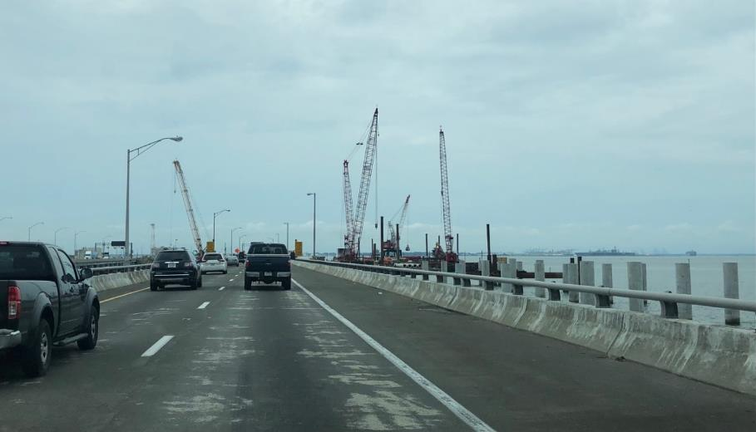
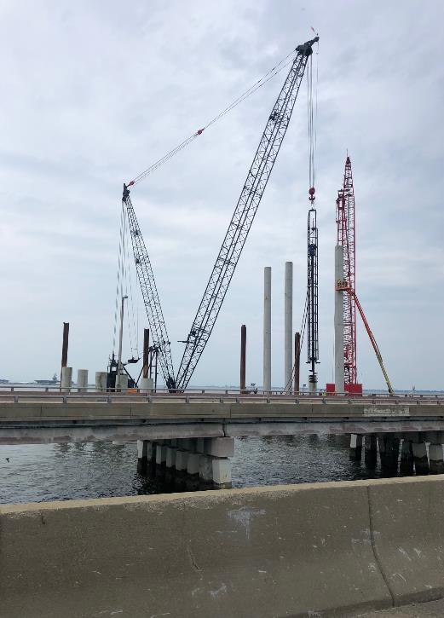
Hampton Roads Bridge Tunnel (HRBT) Expansion

Slide 12
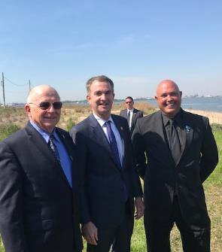
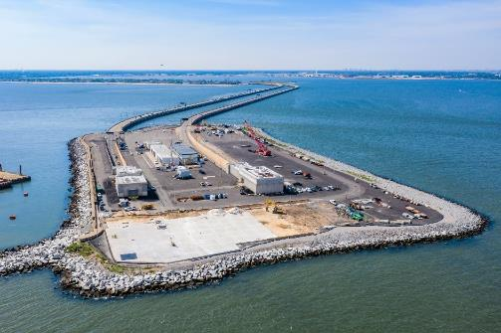
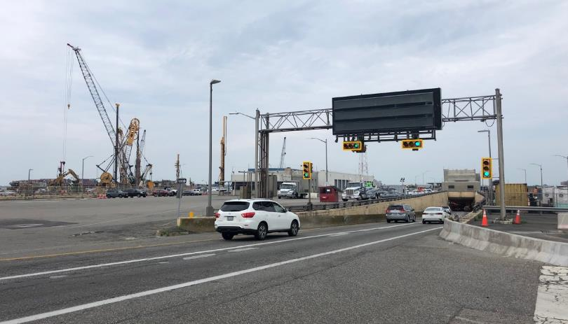
HRBT Expansion Project
Largest single roadway project value in history of Virginia at $3.8 Billion

Slide 13
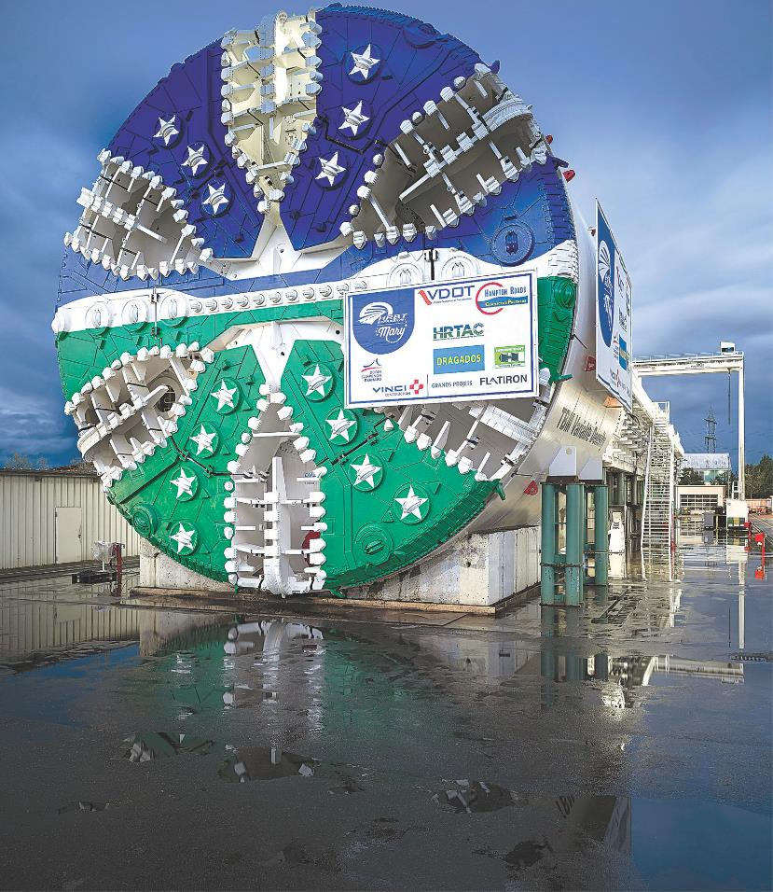

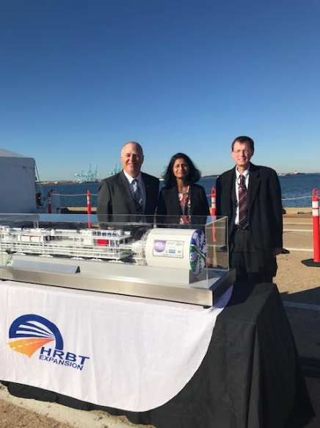
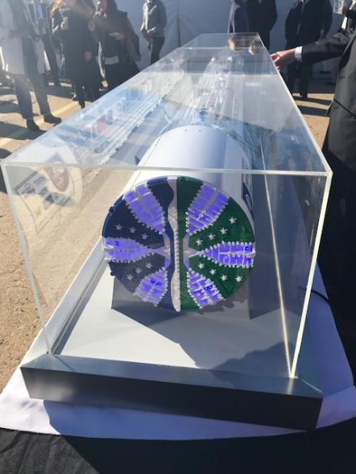


Slide 14
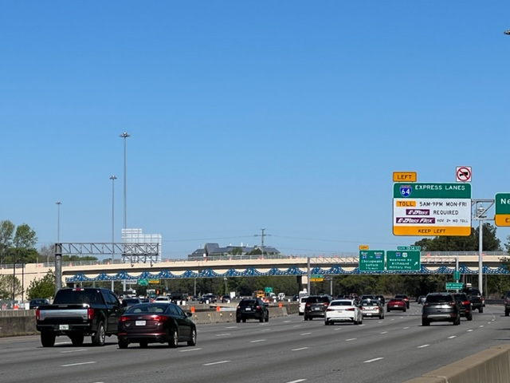
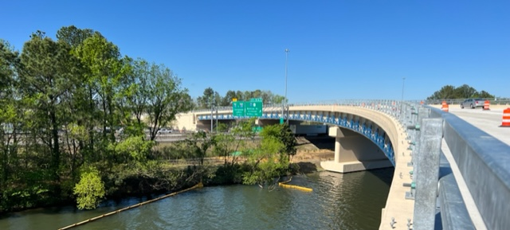
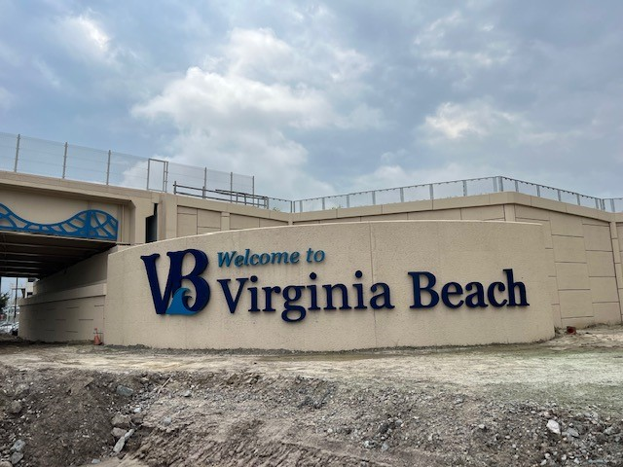
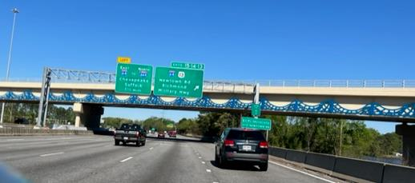
I-64/I-264 Interchange

Slide 15
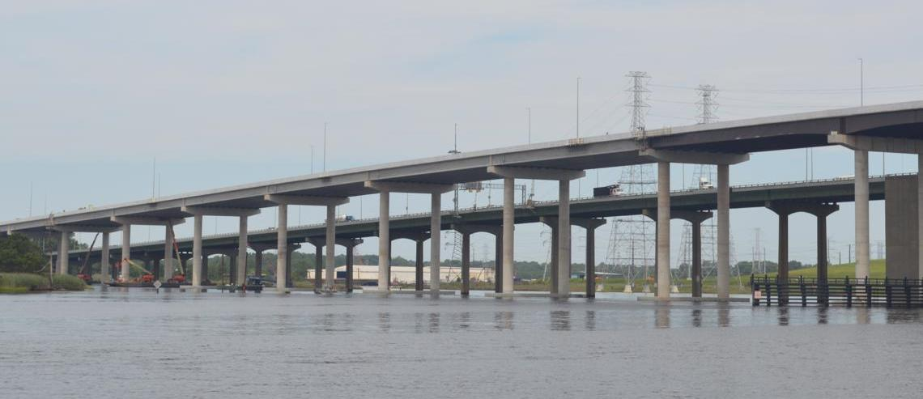
High-Rise Bridge/I-64 Southside Widening

Slide 16
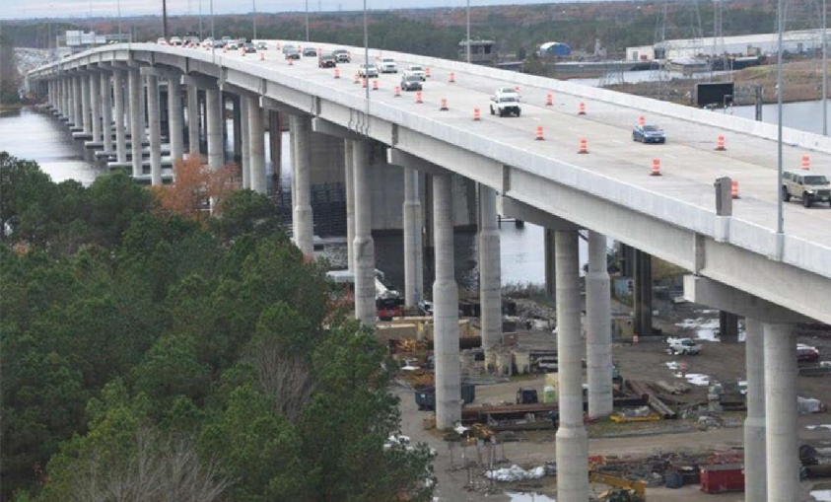
High-Rise Bridge/I-64 South Side
August 2023 completion
9 miles of interstate widening (from 4 to 6 lanes)
New express lane in each direction constructed in the median
Widen six existing bridges
Replace Great Bridge Boulevard Bridge
Construct new High Rise Bridge for traffic toward Greenbrier
Convert existing High Rise Bridge for traffic toward Suffolk

Slide 17
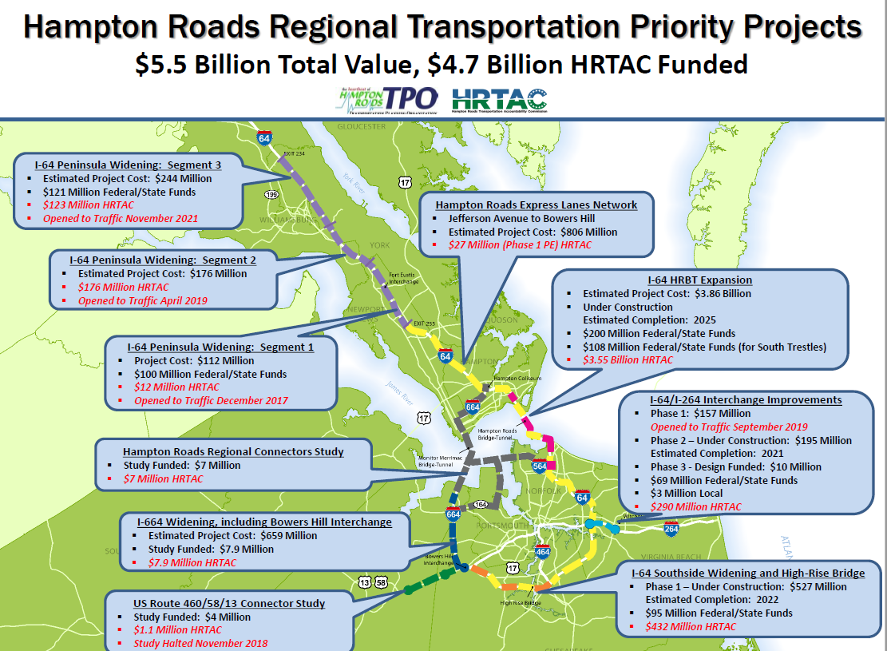

Slide 18
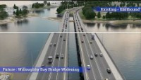

Slide 19
Broadband Update

Slide 20
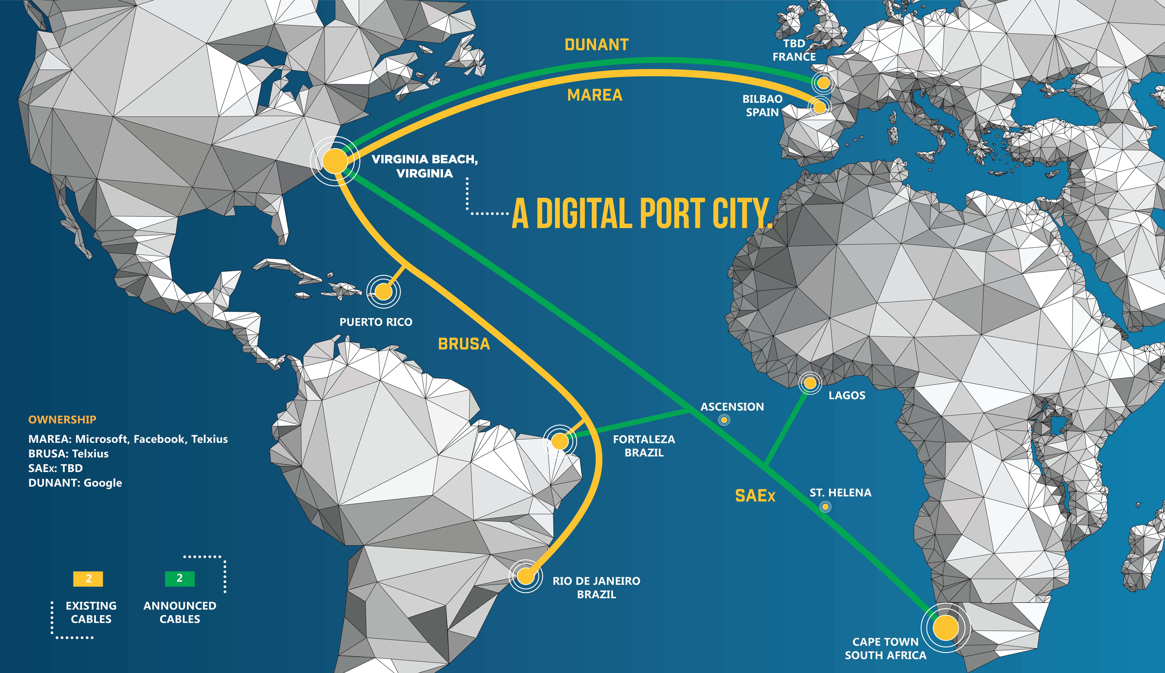
The Network Ring
DIGITAL PORT
The Network Ring will connect to the Trans-Atlantic Subsea Cables landing in Virginia Beach
13

Slide 21
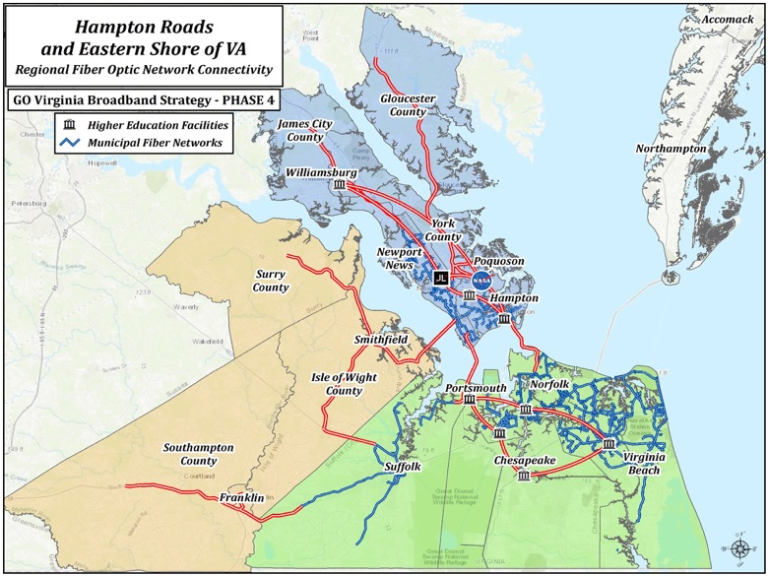
Our Vision
Ultimately, this will be a Fiber Optic Network Ring that will connect our entire 757 Region

Slide 22
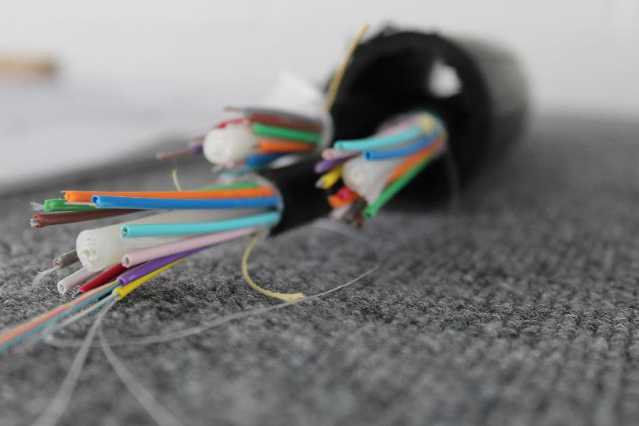
Spring/Summer 2022
3 Groundbreakings
Over 3,000 linear miles of fiber under construction
Notes:
Good morning. I appreciate the opportunity to update you on Southside Network Authority actions regarding the Network Fiber Ring project.

Slide 23
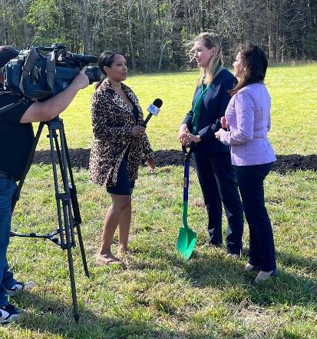
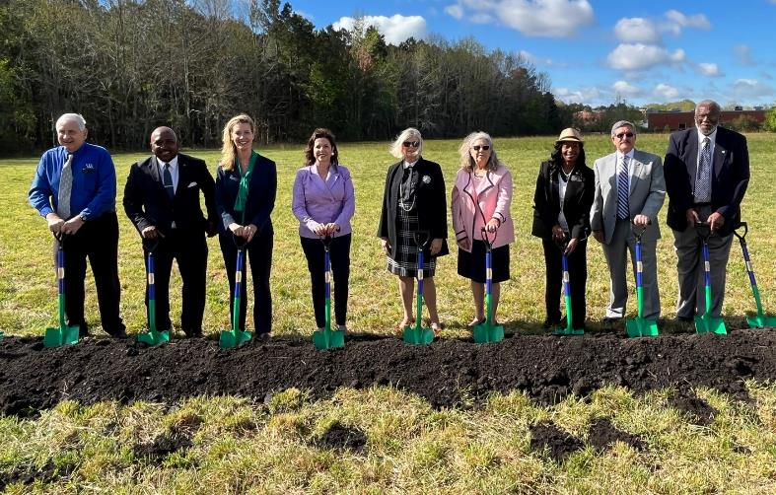
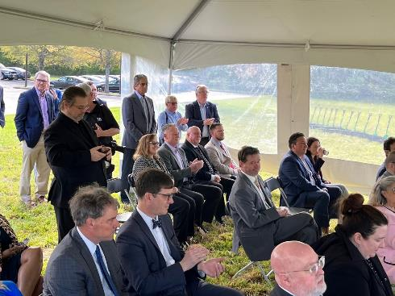
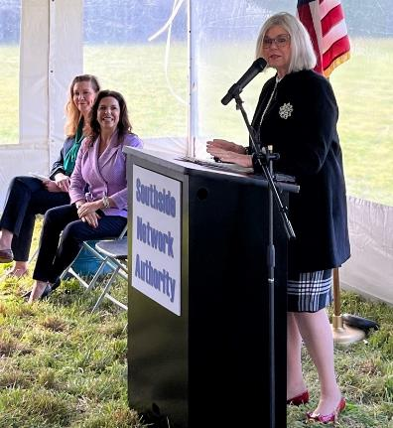
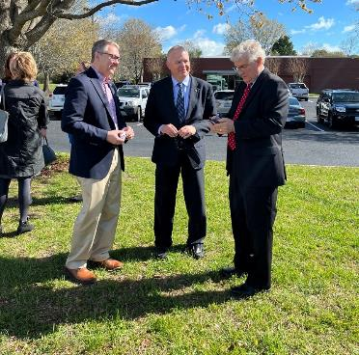
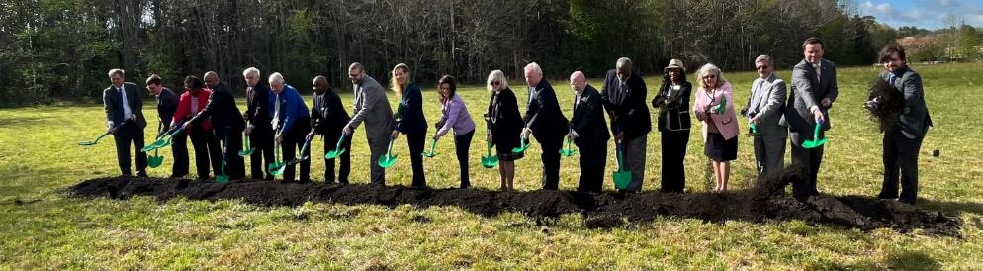
Fiber Ring Groundbreaking
April 6, 2022

Slide 24
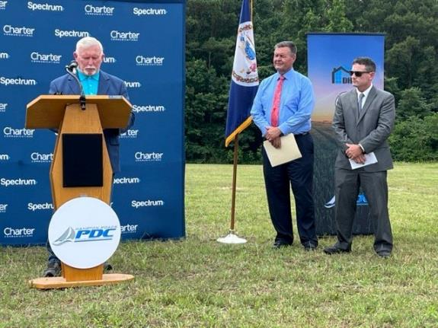
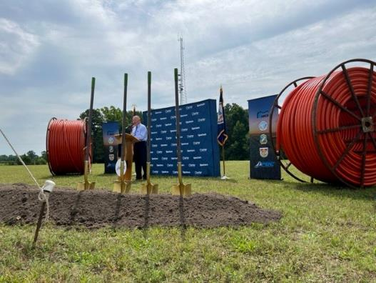
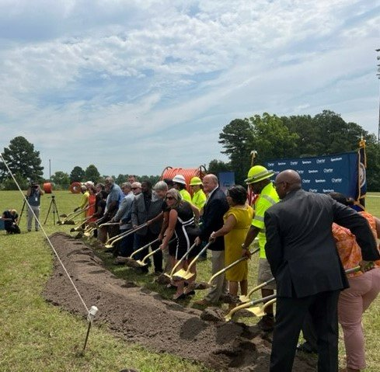
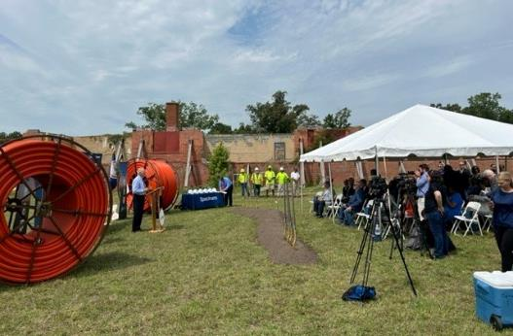
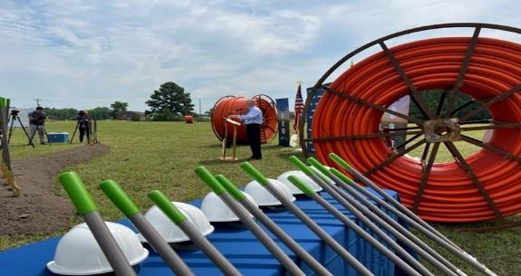
Suffolk, Isle of Wight, Southampton
July 14, 2022

Slide 25
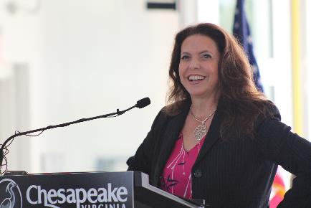
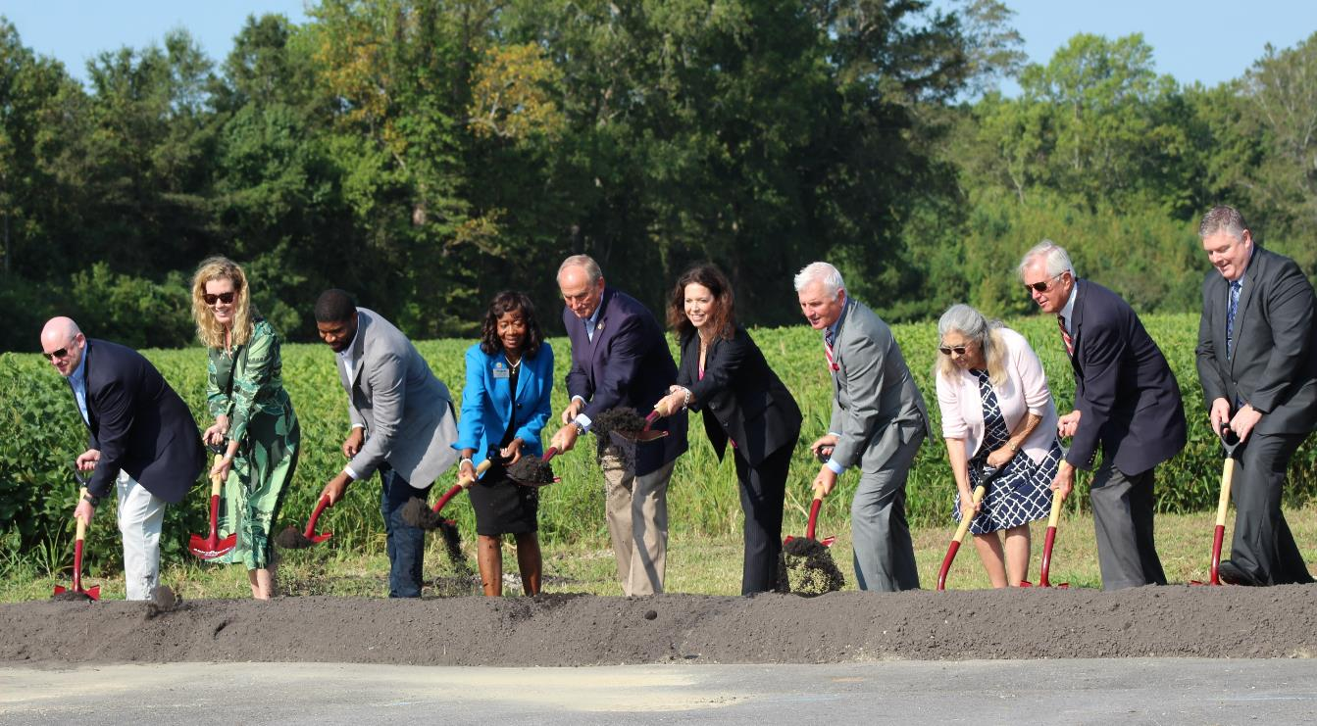
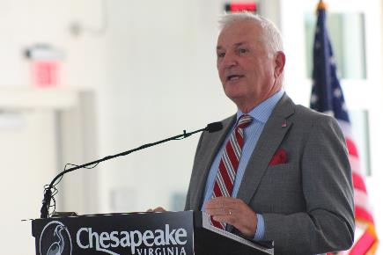
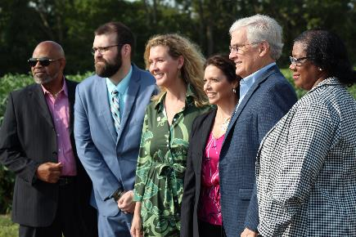
Chesapeake Connects
September 15, 2022

Slide 26
About the Network
Our digital highway consists of 288 digital strands
Fiber optics (optical fibers) are long, thin strands of very pure glass about the diameter of a human hair
  8 Strands Reserved for Cities in the Network*
  Some Strands Reserved for Education
  Other Strands Reserved for Public Safety

Slide 27
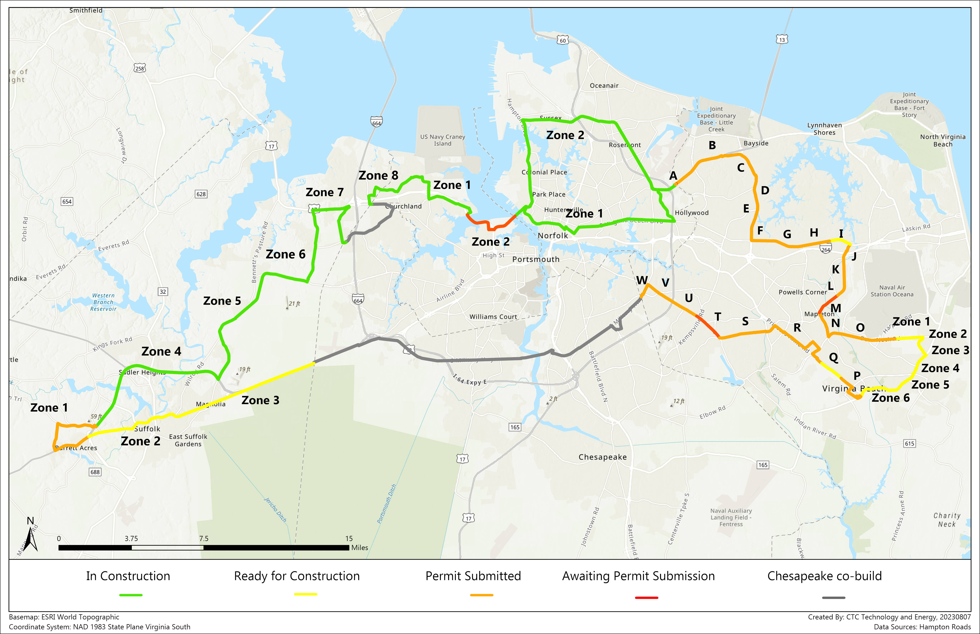
Project Progress Map

Slide 29


Slide 30
Birthplace of America Trail
Project Overview, Opportunities, and Update
Robert Crum
Executive Director
HRPDC/HRTPO

Slide 31

TODAY: WILLIAMSBURG & JAMES CITY COUNTY ARE NEAR ONE END OF A 52 MILE TRAIL

Slide 32

SOON: COULD BE THE CENTER FOR BIKING IN EASTERN VIRGINIA

Slide 34
TA Set-Aside Application (2.0 miles, $1,500,000)
TA Set-Aside Application
(≈1.26 miles , $1,500,000)
TA Set-Aside Application
(≈1.0 miles, $2,370,000)
TA Set-Aside Application
(1.1 miles, $1,474,400)
TA Set-Aside Application (0.4 miles, $1,500,000)

Slide 35
Funding Snapshot
Secured
Federal Lands Assistance Program 2.6 Miles
Smart Scale 2.6 Miles
5.2 Miles
Requested
Transportation Alternatives Set-aside 6.86 Miles
TOTAL 12.06 Miles

Slide 36

Priority Segments

Slide 37
Questions/Discussion

Slide 38
Connect with us!
Facebook:
/hrpdcva
/hrtpova
LinkedIn:
/hrpdc
/hrtpova
Nextdoor:
HRPDC
HRTPO
YouTube:
@HRPDC_HRTPO
Follow us on our social media channels to keep up to date on the newest information and stay engaged in the regional discussion!

