Slide 1

Hampton Roads Investment Playbook
(Phase I)
December 2024

Slide 2








Hampton Roads Investment Playbook - Context
Mega forces are creating a new economic order
This shift is being catalyzed by unprecedented federal spending
A handful of metros are making the most by leveraging their position
Cities and metros can strengthen their position by developing Investment Playbooks
$1.9T
American Rescue Plan
$1.2T
Bipartisan Infrastructure Law (BIL)
$280B
CHIPS and Science Act
$437B
Inflation Reduction Act (IRA)
$850B+
DOD’s FY 2025 Appropriations
Playbook Phase I:
Diagnostics: Assess
New Tech Hubs
Remilitarization
A position in the changing economy
Climate 1st Movers
Playbook Phase II:
Reshoring
Project Identification:
B Conduct interviews across
key sectors
Project Capitalization: Identify public/ private/ civic investments for capital stacks
Trading Powerhouses
Decarbonization
C
Military Metros
4
Source: The New Localism (2024).

Slide 3






Hampton Roads Investment Playbook - Phase I
Goal
Areas of analysis
Our approach
❏ Assess the positioning of the region in the new economic order
❏ Identify strengths and areas of opportunity
Initial assessment of regional trends and strengths, then focus on three specialized areas:
❏ Federal Procurement & Grant Spending
❏ Green Supply Chains
❏ Key Technology Focus Areas
❏ Combine quantitative and qualitative information
❏ Identify distinctive assets in the new economic order
❏ Assess strengths and weak links in the ecosystem
● Assess the positioning of the
region in the new economic order
● Identify strengths and areas of opportunity
● Federal Spending
● Green Supply Chains
● Critical Technologies
● Investments & Trade
Timeline
Geography
Interviews conducted
❏ May: kick-off, literature review and data gathering
❏ June: early version of the diagnostic and in-person visit
❏ July: deep dives into priority areas and final Playbook (Phase I)
❏ August-September: feedback and updates to the presentation
❏ Hampton Roads region, comprising the Virginia Beach- Norfolk-Newport News, VA/NC MSA
❏ Huntington Ingalls Industries, NASA Langley, SURA (Jefferson Lab), Port of Virginia, Virginia Tech, US Navy (See complete list on the Appendix)
● Assess the positioning of the
region in the new economic order
● Identify strengths and areas of opportunity
See complete list of interviews in Appendix A
3
Source: The New Localism (2024).

Slide 4
Hampton Roads Investment Playbook | Playbook Components
Hampton Roads Investment Playbook Phase I
Economic assessment of regional trends and strengths, with a focus on Federal Procurement, Green Supply Chains and Key Technology Areas.
Interviews Conducted for Phase I:
Playbook
Phase I
A
Diagnostics
Assess position in the changing economy
Organization | Stakeholder | Position
US Navy | Matt Zirkle | Former Rear Admiral
HR Regional Planning District Commission | Bob Crum | Executive Director
HR Military & Federal Facilities Alliance | Todd Nichols | Deputy Executive Director
HR Military and Federal Facilities Alliance | Rick Dwyer | Executive Director
Jefferson Lab (SURA) | Sean Hearne | President & CEO
NASA Langley | Deborah Tomek | NASA Senior Executive
NASA Langley | Brandi Quam | Business Development Specialist
The Port of Virginia | Stephen Edwards | CEO & Executive Director
Hampton Roads Workforce Council | Sean Avery | CEO
Virginia Peninsula Chamber | Bob McKenna | President/CEO
HR Executive Roundtable | Nancy Grden | President & CEO
Virginia Tech | Brett Malone | Executive Director
Virginia | Chelsea Jenkins | Deputy Secretary of Commerce and Trade
Playbook Phase II
Project identification
Conduct interviews across key sectors
B
Project capitalization
Identify public/private/civic investments for capital stacks
C
5
Source: The New Localism (2024).

Slide 5
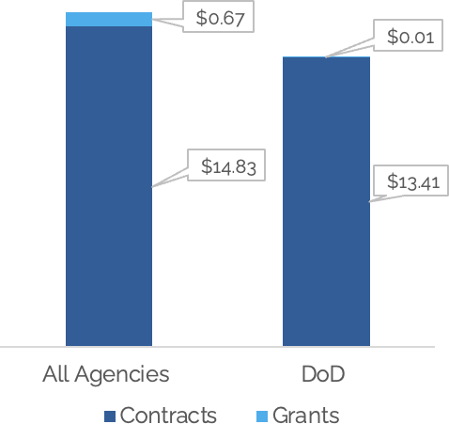
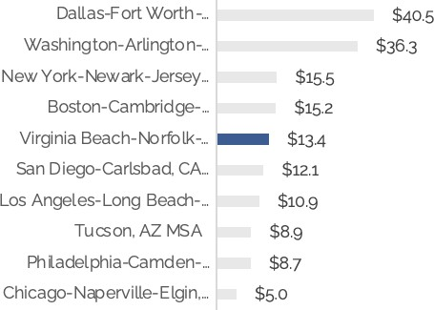
Federal Procurement | A Remarkably Robust Economy
Opportunity Size
National Positioning*
Spending Characterization
~$15.5 billion in contracts and grants are allocated for the Hampton Roads region every year. Of this amount, 96% were contracts, with 90% awarded by the DoD.
The region's average annual intake of $13.4 billion in DoD contracts and grants makes it the fifth largest U.S metro for DoD spending Note: We are developing the first- ever U.S. metro ranking by DoD spending.
The bulk of DoD expenditure in Hampton Roads is concentrated within three municipalities: Virginia Beach, Norfolk and Newport News and three sub agencies.
Hampton Roads Federal Procurement & Grant Spending by Agency and Type (4-Year Avg, $B)
Top 10 US Metros with Highest DoD Contract Spending (4-Year Avg, $B)*
HR DoD Procurement Spending by Top Municipalities and sub agencies (4-Year Avg, $B)
Top Municipalities
→ Virginia Beach: $ 4.2 B (31%)
→ Newport News: $ 3.8 B (28%)
→ Norfolk: $ 3.0 B (22%)
Top Sub Agencies
→ NAVY: $7.9 B (53%)
→ DLA $ 3.5 B (24%)
→ Air Force: $ 889 M (6%)
Note: (*) We are using data on all contracts and grants awarded by the DoD from 2020-2024. The ranking depicts the top metros with the most annual average spending spending. Specifically, we calculated the total obligated amount across contracts and grants where the primary place of performance was a specific metro, and we ranked them accordingly. We also provided rankings based on specific sectors such as manufacturing, professional services, and administrative services. Source: The New Localism (2024) based on USASpending.
10

Slide 6
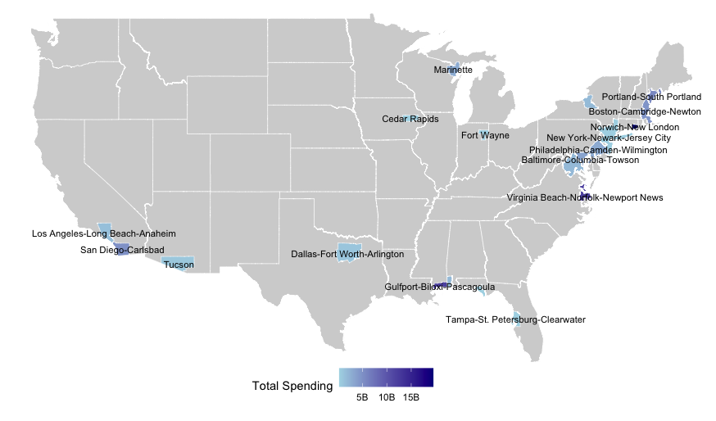
Federal Procurement | Cornerstone of the Submarine Industrial Base
Inter Metro: The industrial bases for aerospace manufacturing and submarine production are highly concentrated
Total Spending of DoD Manufacturing Contracts Over $250M in Submarines and Naval Boat Building by Metro Area (2021–2024)
Analysis of USA Spending data on high-value defense contracts (over $250 million) highlights Hampton Roads as the second-largest metro for submarine and naval manufacturing spending ($12.3 billion).
These contracts represent some of the largest investments by the DoD, signaling projects of national significance involving key defense manufacturers and critical infrastructure, solidifying the region's role as a cornerstone of the Submarine Industrial Base (SIB).
NOTE: In overall Navy manufacturing, Hampton Roads ranks 4th nationally ($12 billion), following Dallas ($53 billion), Norwich ($18 billion), and Hartford ($14 billion), further reinforcing its critical contribution to defense manufacturing and national security priorities.
Top 3 Metros: Norwich-New London ($19.5 billion); Virginia Beach-Norfolk-Newport News ($12.3 billion); Gulfport-Biloxi-Pascagoula ($11.96 billion).
Top 3 vendors: Huntington Ingalls, Electric Boat, and Raytheon (concentrate 62% of spending).
Note: Aerospace spending covers NAICS codes for aircraft, missile, and engine manufacturing. Submarine spending includes shipbuilding, navigation systems, and boat manufacturing NAICS codes. Source: Nowak Metro Finance Lab (2024) based on USASpending.
6

Slide 7
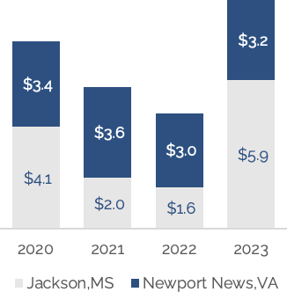
Federal Procurement | Pressure on the Region’s Top Suppliers
Huntington Ingalls Direct Federal Contracts
by Year and Recipient Location
(2020-2023, $B)
DoD FY 2025 Budget Highlights for Submarine Production
$48.1B
SEA POWER
INVESTMENTS
Including the construction of a Virginia-class submarine
Key Insights:
Steady Production: Newport News has maintained consistent DoD spending, averaging $3.3 billion annually, indicating a stable base for future growth.
Jackson Surge: HII Jackson location's contract funding surged to $5.9 billion in 2023, driven by major DoD contracts for DDG 51 destroyers and LPD 30 amphibious transport docks, signaling potential growth opportunities for Newport News.
Huntington Ingalls’ Newport News location faces significant delays in expanding its supplier base, which is a major obstacle to fully meeting the rising demand for submarines.
$9.9B
NUCLEAR POWERED SUBMARINES
Part of Nuclear Enterprise Modernization Strategy
$143.2B
RDT&E
Part of which will be focused on submarine technology
The 2025 DoD budget places significant emphasis on submarine production, intensifying the pressure on HII to not only meet this demand but also to expand its supplier base accordingly.
Source: The New Localism (2024) based on USASpending, Defense Budget Overview, DoD FY 2025 Budget Request.

Slide 8
Hampton Roads Investment Playbook | 7 Strategic Projects Identified
1 | Creation of a DOD backed AUKUS Center of Excellence, with a consortium of researchers in submarine related innovation and production from Australia, the UK and the US. This Center could build on the globally recognized Advanced Manufacturing Research Centre in Sheffield, England, which features integrated efforts around applied R&D, workforce training and entrepreneurial growth.
2 | Creation of an Innovation Constellation to bring greater coherence and collaboration between related anchor corporations, universities and federal research labs located in the metro area. The key is to work with multiple stakeholders to design a clear set of projects to advance innovation capabilities in a largely production-oriented economy.
3 | A concerted Choose Hampton Roads effort to recruit and attract key supply chain firms in leading industries like shipbuilding and repair, nuclear power and wind energy. Such an effort would naturally involve the identification of suitable sites for firms as well as integrated approaches to workforce development. To the greatest extent possible, the location of firms should occur in a way that fills out existing areas with a greater density of industry actors.
4 | Creation of a Hampton Roads Consortium of Talent to upgrade the offerings of engineering degrees at ODU and other four-year universities to support the region's production economy and upgrade the skills of workers in close collaboration with high schools, skills providers and community colleges. Metros like Kansas City are also contemplating the creation of an Instructor Corps to ensure that the supply of teachers for technical trades matches the manufacturing demand.
5 | New contractual relationships with major defense installations and research laboratories to pioneer the rapid transition to reliable and resilient energy sources and load management.
6 | Maximized use of the Inflation Reduction Act to accelerate the energy transition and advance climate resilience, particularly around government and university campuses and a city-wide building upgrade program to modernize and climate-proof homes.
7 | Discrete projects focused on enabling companies to move ideas to market, from R&D to testing and commercialization of these technologies, taking full advantage of federal resources (e.g., SBIR, STTR awards). This could entail developing an accelerator on specific technologies needed for this region.
6
Source: The New Localism (2024).

Slide 9





Hampton Roads Investment Playbook | What’s Next?
Phase I:
Research context and identify opportunities
Phase II:
Refine opportunities and draft Playbook
Phase II:
Project implementation
Key activities:
Key activities:
Key activities:
Conduct rigorous quantitative economic analysis (industry analysis, small business ecosystem, workforce profile etc.)
Conduct 1:1 interviews with local stakeholders to identify investments
Timeline:
3 months
Hold working sessions with key local stakeholders to refine project ideas
Determine project costs and potential funding sources
Conduct site visits to other
cities to learn best practices
Raise capital from identified funding sources
Identify local leaders and practitioners to drive projects forward
Estimated Timeline:
1.5 months
Estimated Timeline:
1 month
19
Source: The New Localism (2024).

Slide 10


Hampton Roads Investment Playbook | What’s Next?
Investment Playbooks identify needed investments and match them to federal, state, and civic sources that can maximize the cumulative local effect of the investments.
Federal funding
Including influx of COVID recovery funds and hundreds of competitive programs and tax cuts
Investment Playbook Identifies local priorities and matches federal sources to local uses
State funding
Including program and discretionary funds, tax breaks, and more from COVID recovery and legacy programs
Private funding
Including both local and outside investors providing a variety of debt and equity to local projects
Includes local projects in:
Innovation
Workforce Development
Business Attraction & Expansion
Energy Infrastructure
Land Management & Use
Philanthropic funding
Including grants and low-cost debt and equity invested in the community
21
Source: The New Localism (2024).

Slide 11
Hampton Roads Investment Playbook
(Phase I)
Thank you!
December 2024

Slide 12
Green Supply Chains - Opportunity Areas
Hampton Roads: Positioning of Selected Green Supply Chains.
Opportunity Areas*:
We identified three green supply chains where Hampton Roads has
a strong position that could be further leveraged.
Low | Medium | High
EV Charging Infrastructure Electric Vehicles Batteries | Nuclear Power Grid & Microgrid
Semiconductors Solar Energy | Wind Energy
Materials | Green Hydrogen
Nuclear Power
Dominion Energy is a key player in the large-scale generation of nuclear power in the state and region. The area's strong maritime and defense industries drive industry applications, yet the supply chain footprint is mostly concentrated in power generation. There may be opportunities for further innovation around nuclear power applications.
Ecosystem Readiness
Grid & Microgrid
Dominion Energy plays a pivotal role in advancing the grid through innovative technologies like unmanned systems. Additionally, institutions such as Old Dominion University and the Department of Energy are involved in research initiatives for microgrid technologies. The region needs to strengthen its innovation ecosystem and foster collaboration among key stakeholders.
Wind Energy
The region is at a turning point in its efforts to become a wind energy leader. While local colleges have been instrumental in developing specialized talent, the forecasted creation of over 1,100 jobs through the CVOW project will require further efforts to build a skilled workforce. Additionally, the region must address its reliance on international suppliers.
Stakeholder Strength
15
Note: (*) To identify a subset of green supply chains that offer opportunities for the region, additional qualitative analyses were conducted. Source: The New Localism (2024).

Slide 13
Key Technology Areas - Opportunity Areas
Hampton Roads: Positioning of Selected Technologies.
Low Medium High
Opportunity Areas**:
We identified 3 technologies where HR has a strong position that could be further leveraged for use in both civilian and defense sectors
Advanced Materials Science | Advanced Energy Efficiency High Performance Computing* | Cybersecurity, Data Storage, Data Management
Quantum Information Science | Advanced Communications | Advanced Manufacturing
Biotechnology & Medical technology | Artificial Intelligence Disaster Prevention or Mitigation
Cybersecurity, Data Storage, Data Mgmt.
The region has a strong military presence, a vibrant shipbuilding industry, and a growing wind energy sector that fuels demand for technology applications. However, there is a need to develop a platform that strengthens connections between academia and industry and provides capital to move ideas to market.
Ecosystem Readiness
Advanced Energy Efficiency
The region offers a favorable environment for advancing energy efficiency technologies, particularly those related to wind energy and nuclear power. Colleges are leading the way in generating specialized talent, but there is still a need to enhance R&D and innovation given the growing market for these technologies in the region.
Advanced Mfg. (includes Unmanned Systems)
Advanced mfg. technologies benefit from a prosperous ecosystem for testing and innovation, due to both the presence of key players and the demand for these technologies. Hampton Roads is particularly well positioned to advance technology applications in autonomous systems, with organizations such as NASA Langley (which has strong research capabilities in unmanned systems and hypersonics), Huntington Ingalls, DroneUp, Dominion Energy, and ODU driving innovation in these areas.
Stakeholder Strength
Notes: (*)There is considerable scope for the application of artificial intelligence in the region, although the level of current activity is relatively limited. (**) To identify a subset of Key Technologies that offer opportunities for the region, additional qualitative analyses were conducted. Source: The New Localism (2024) based on research.
18

