Slide 1


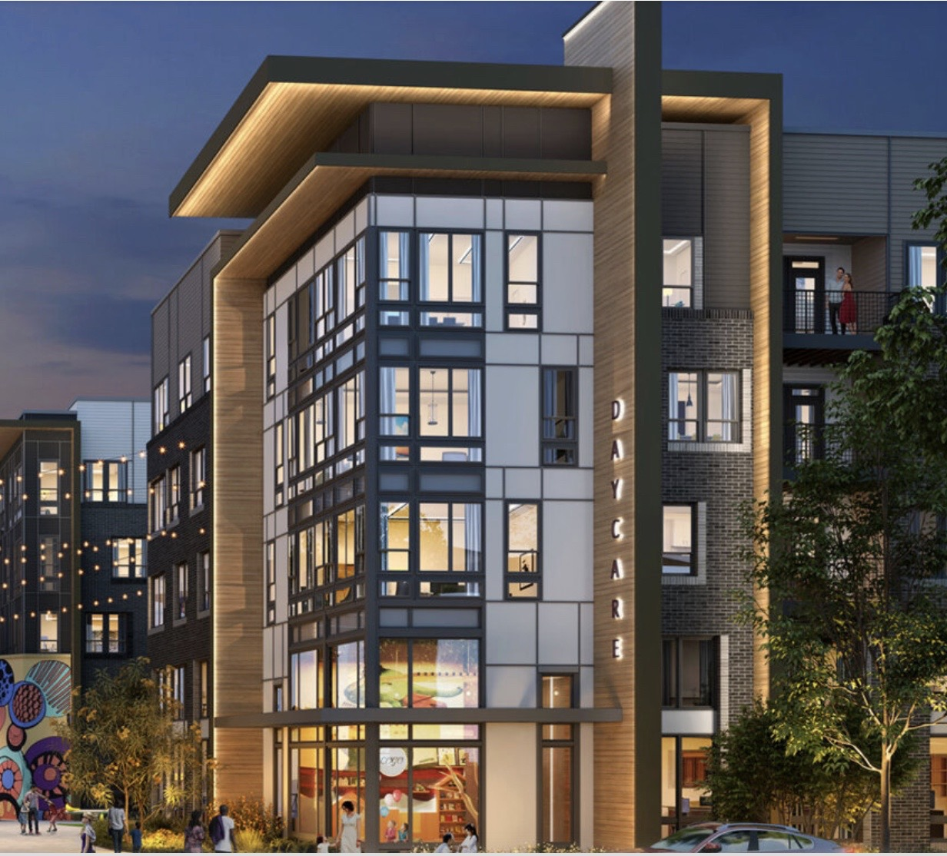

c
Chesapeake Alliance
Building a Regional Alliance to
Promote Housing Affordability
12-15-25
Jill Norcross
Northern Virginia Affordable Housing Alliance
Fairfax Crest, Fairfax County

Slide 2
c
Northern Virginia Affordable Housing Alliance (NVAHA)
Our mission at NVAHA is to increase supply of and equitable access to affordable housing in Northern Virginia through education, advocacy, and community partnership.
We believe in a future where everyone has access to quality affordable housing in a neighborhood where they can thrive.
Our core beliefs:
Housing is about people.
Housing is a racial equity issue.
Housing is a health equity issue.
Housing is economic development.
Housing should be inclusive.
Housing is achieved through partnerships.

Slide 3

What we do….
* Free Monthly Lunch & Learn Programming
* Monthly Housing in Action Newsletter – Local, State, Fed.
* Convening & Advocacy Opportunities
* Boards, Committees, Commissions
* Local Alliances – Arlington, Alexandria, Fairfax, Loudoun, Prince William
* Technical Assistance (Fee for Service Work)
* Annual Leckey Forum and Awards Event
* Rising Housing Leaders Program
We are here to help……

Slide 4
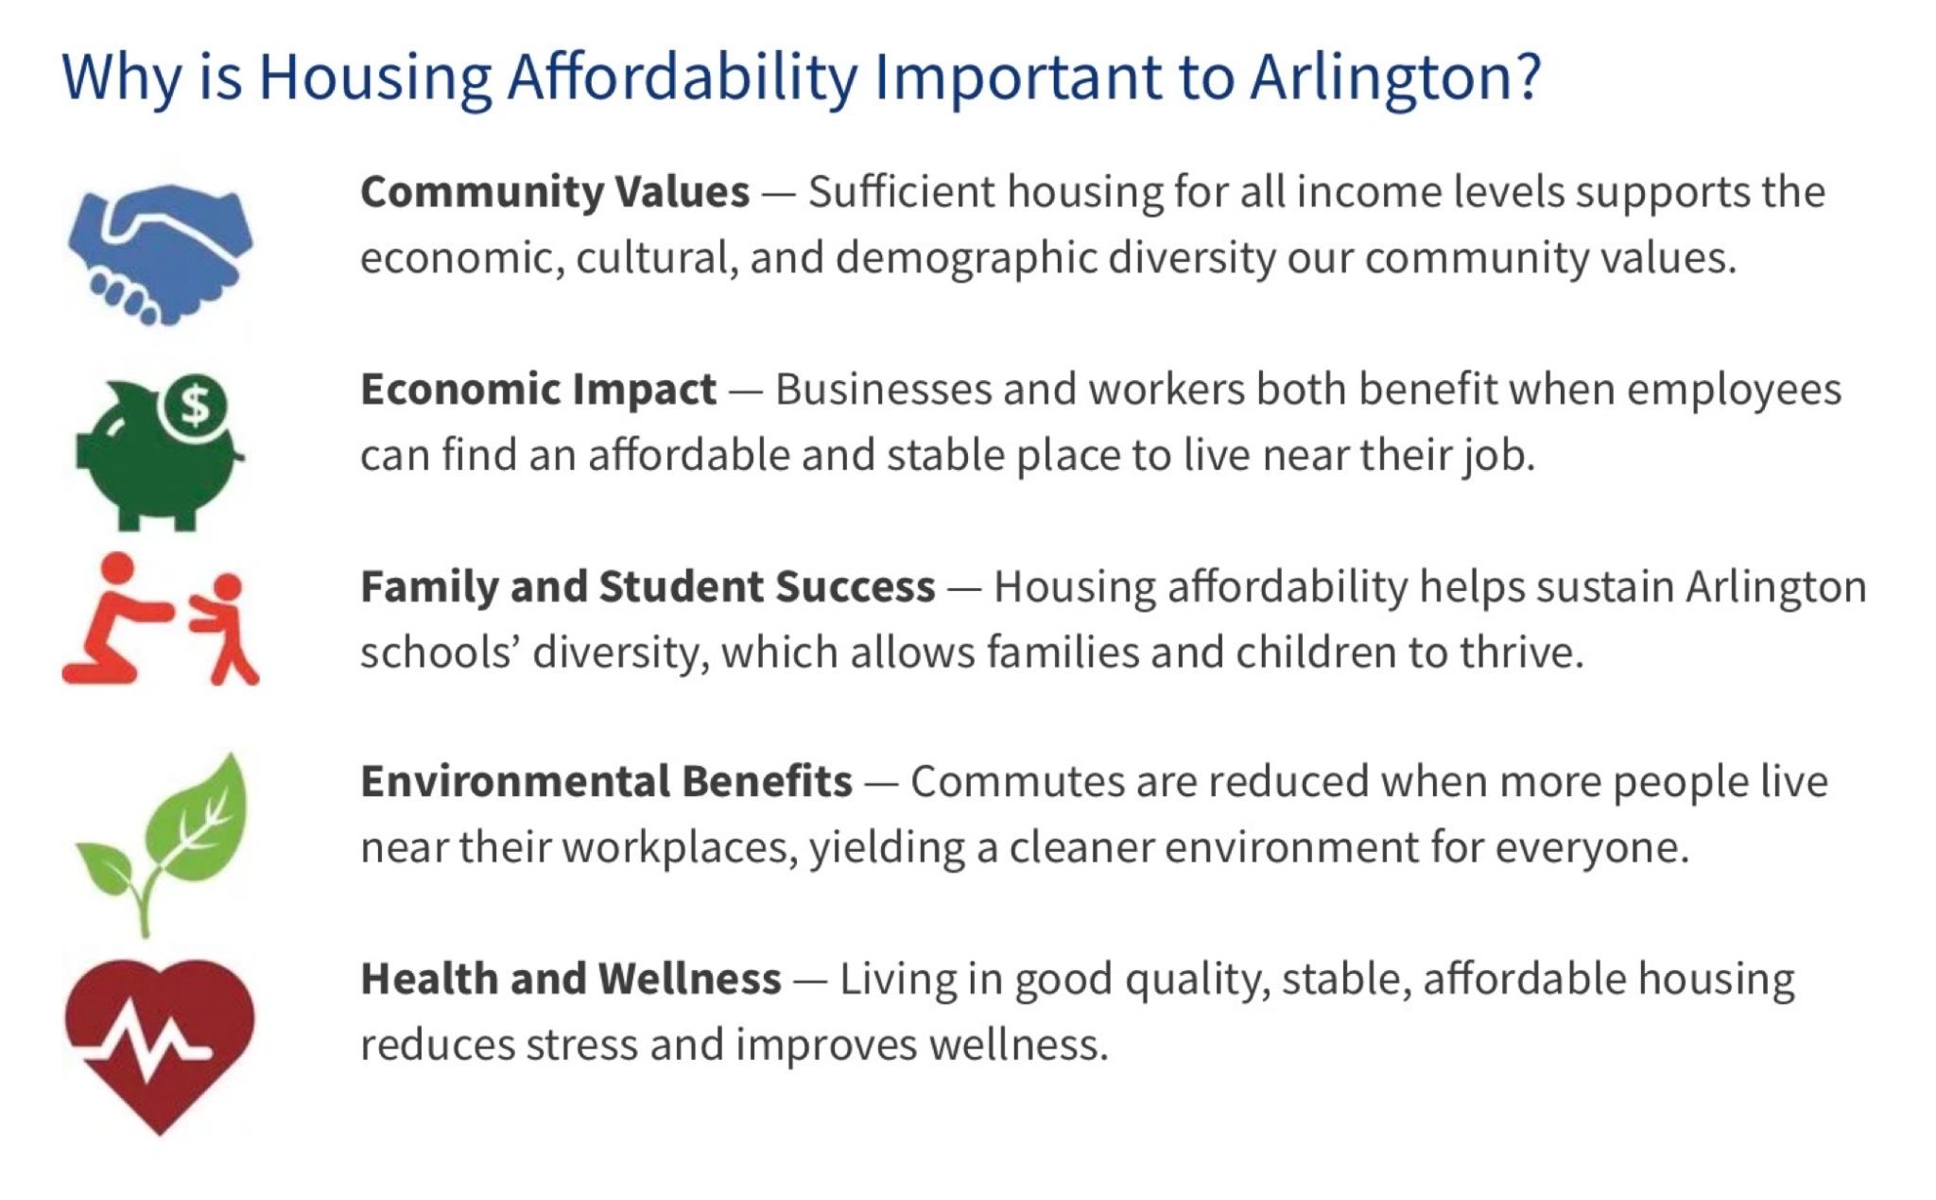
Why Does Affordable Housing Matter?

Slide 5
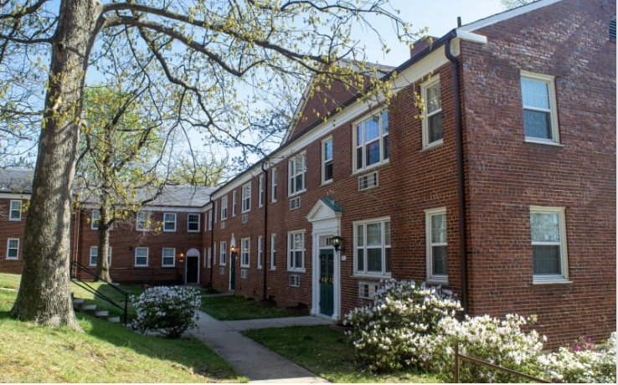
Definitions
Affordable Housing (Practical Definition): Housing is affordable when a household can pay their rent or mortgage and have money left over for food, transportation, healthcare, child care, and any other basic needs.
Affordable Housing (HUD Definition): Housing is considered affordable if an individual or family spends no more than 30% of their gross monthly income on housing costs.
We have a range of affordable housing options because we have a range of incomes. Affordable housing can include rental housing and homeownership.
Affordable housing IS workforce housing.

Slide 6
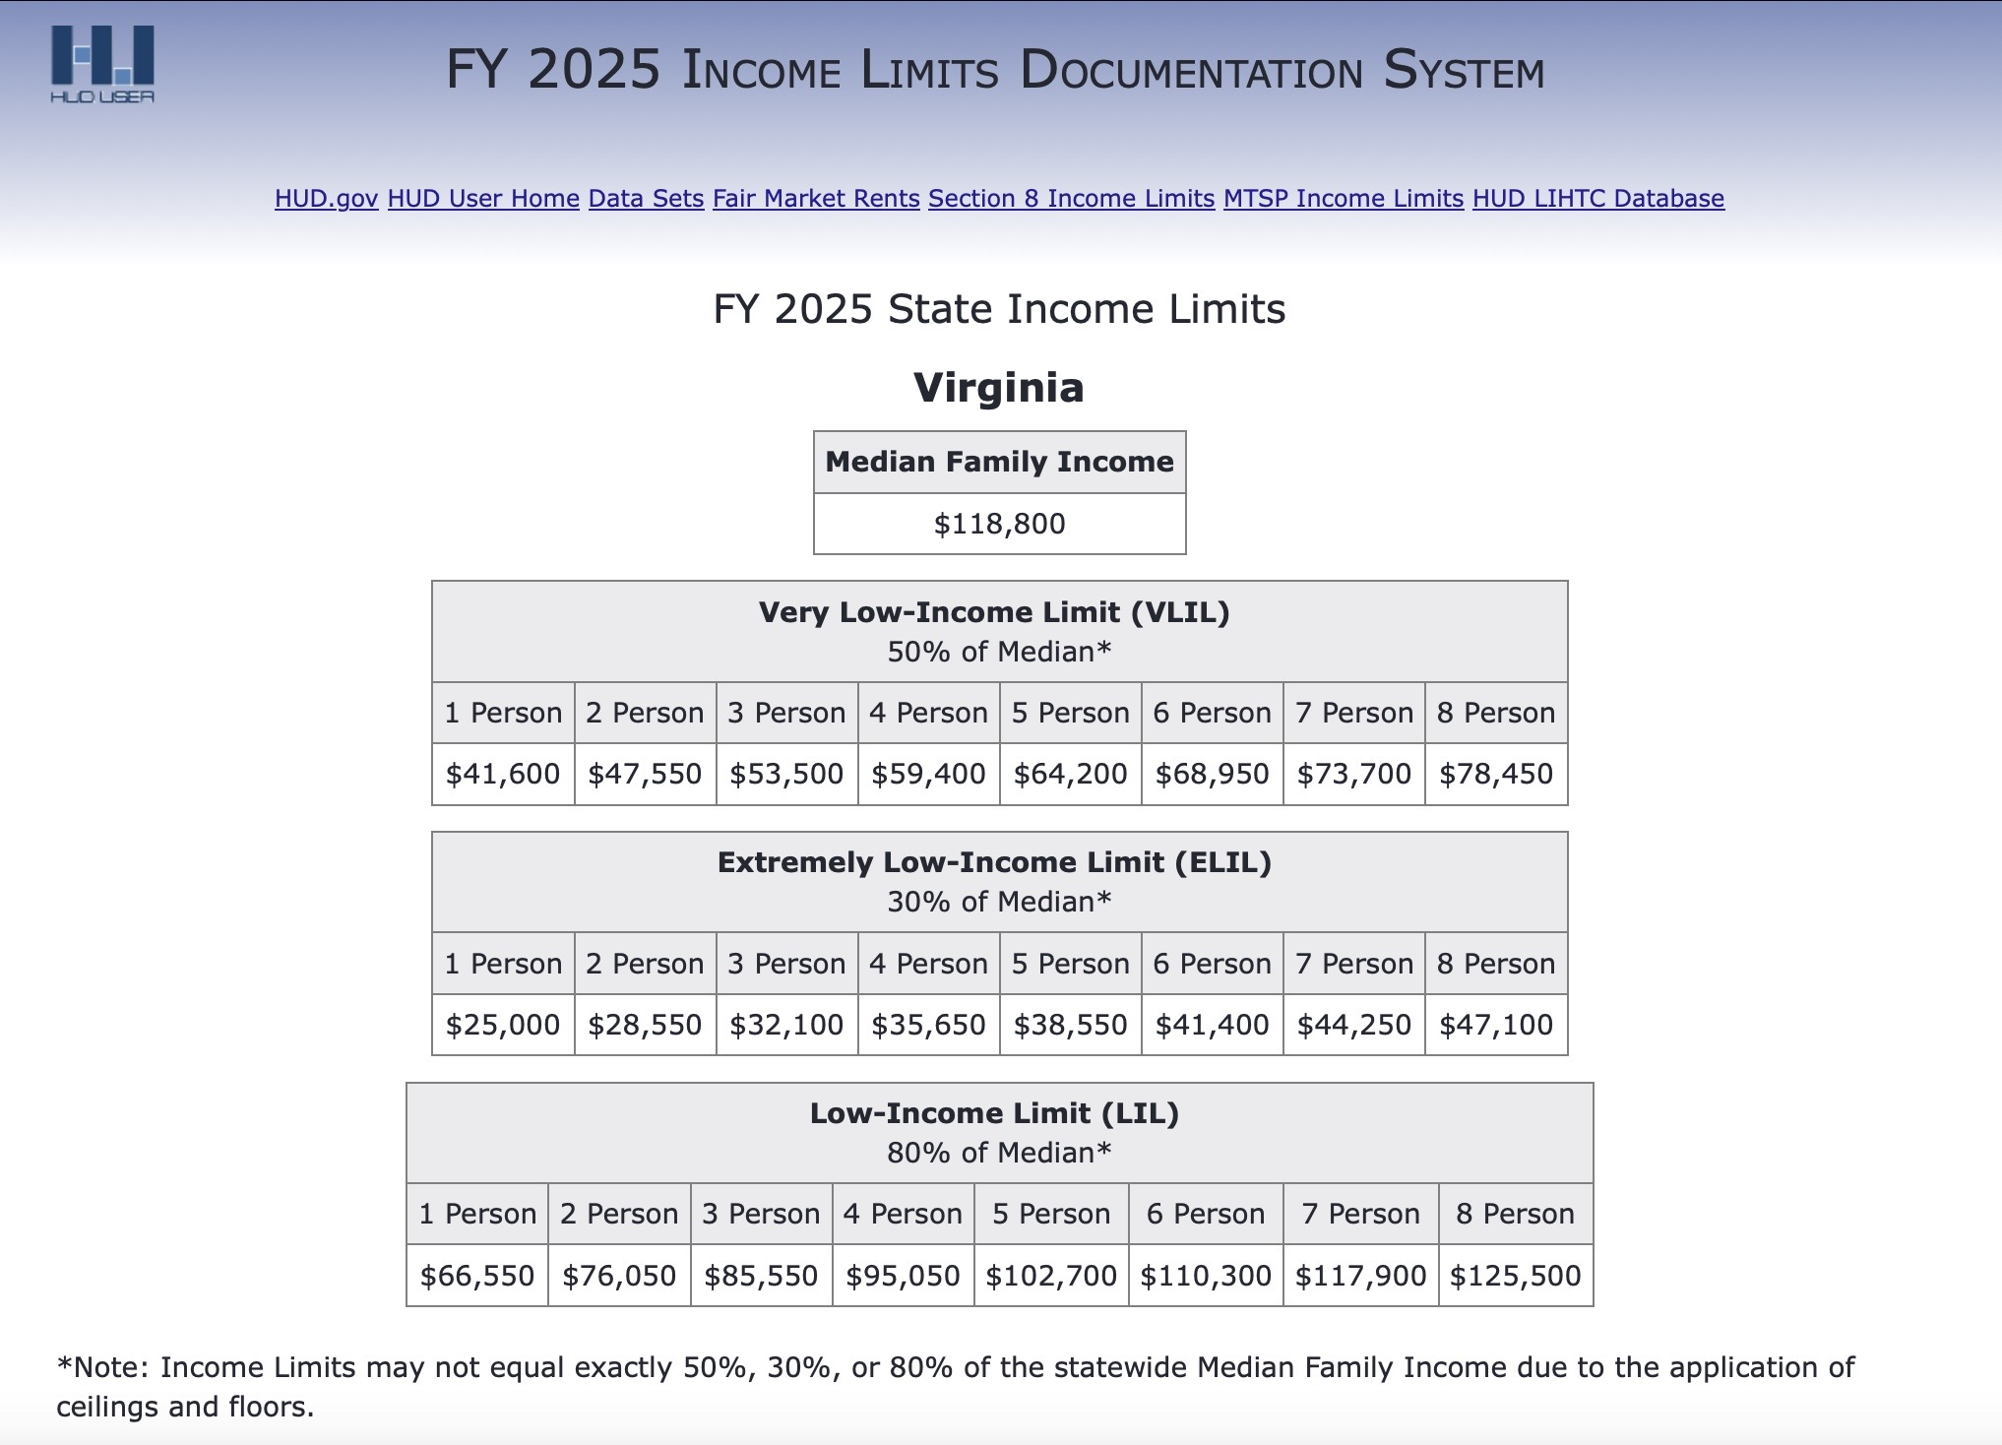
Who qualifies for housing assistance in VA?

Slide 7
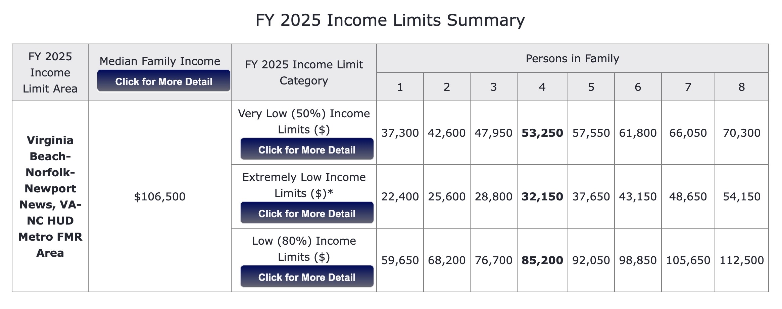
Who qualifies for housing assistance in Hampton Roads?

Slide 8
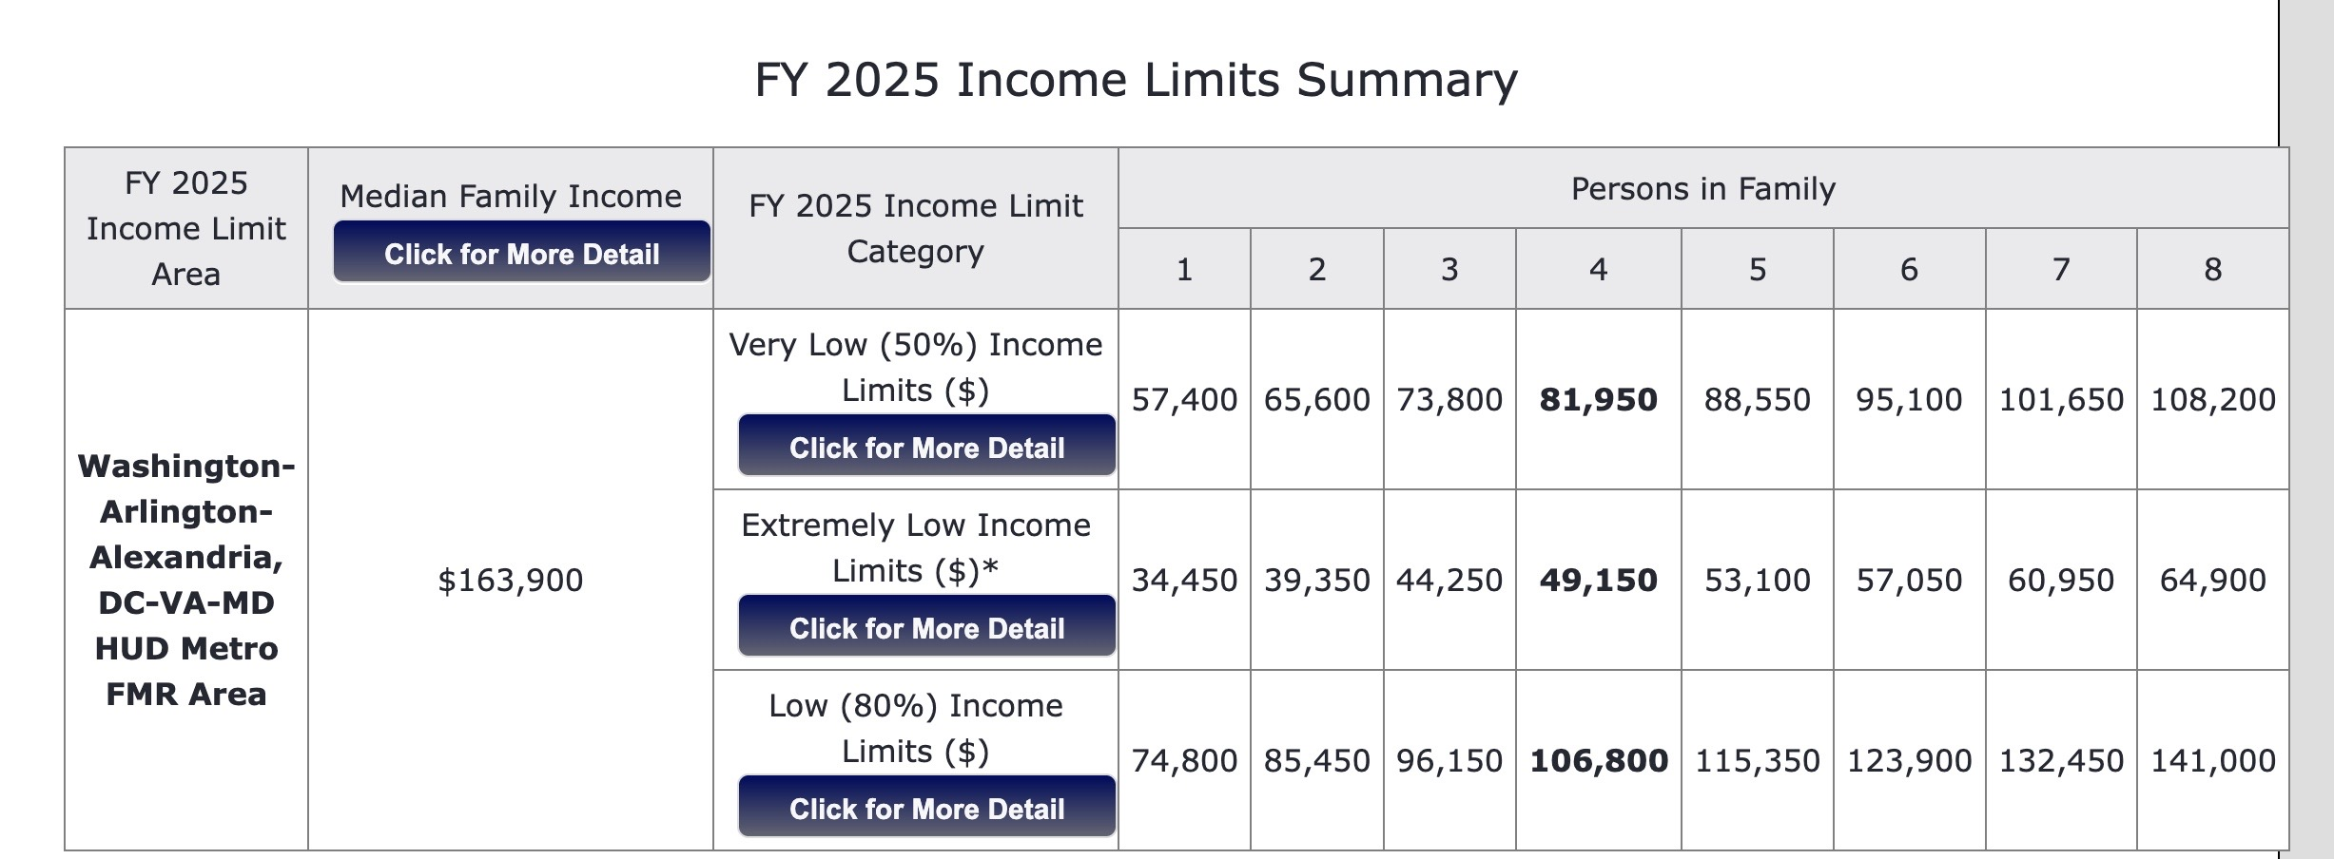
Who qualifies for housing assistance in NoVA?

Slide 9
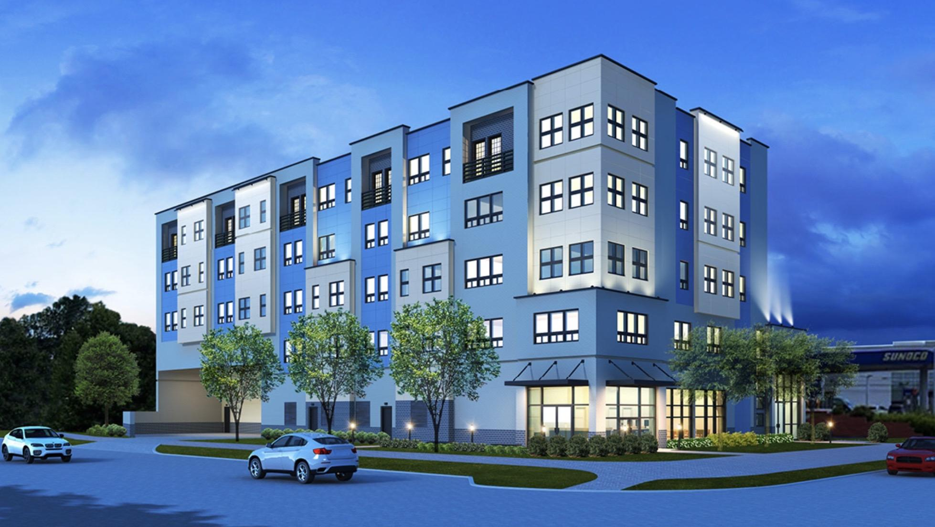

How Much Does it Cost to Live in Virginia, Loudoun & Chesapeake?
According to the National Low Income Housing Coalition’s 2025 Out of Reach Report:
A Virginia family must earn a wage of $30.25 per hour to afford the average
two bedroom market rate apartment
A resident of 20176 (Loudoun County) must earn a wage of $40.00 per hour.
A resident of 23324 (Chesapeake) must earn a wage of $27.50
Virginia’s minimum wage is $12.41 per hour.
Who are we leaving behind?
Older Adults
Working Families
Low-income Workers
Individuals with Disabilities and People Experiencing Homelessness
Source: https://nlihc.org/oor

Slide 10
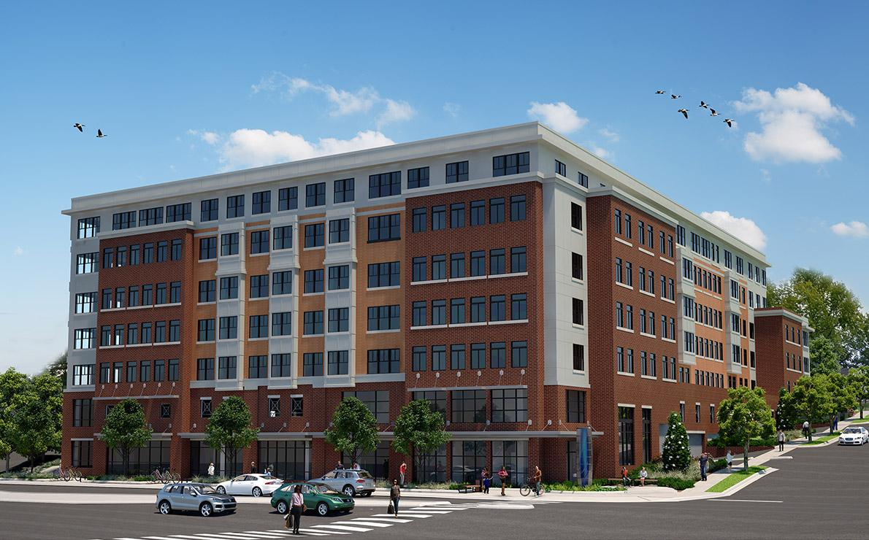
Metropolitan Washington Council of Governments: Regional Housing Goals
By 2030:
Amount: 320,000 housing units added across the region (25,ooo homes per year).
Accessibility: At least 75% of all new housing should be in activity centers or near high-capacity transit.
Affordability: At least 75% of new housing should be affordable to low- and middle-income households.
Source: Regional Housing Targets - Housing & Homelessness | Metropolitan Washington Council of Governments
There is a Housing Shortage of 300,000 affordable rental homes in Virginia

Slide 11
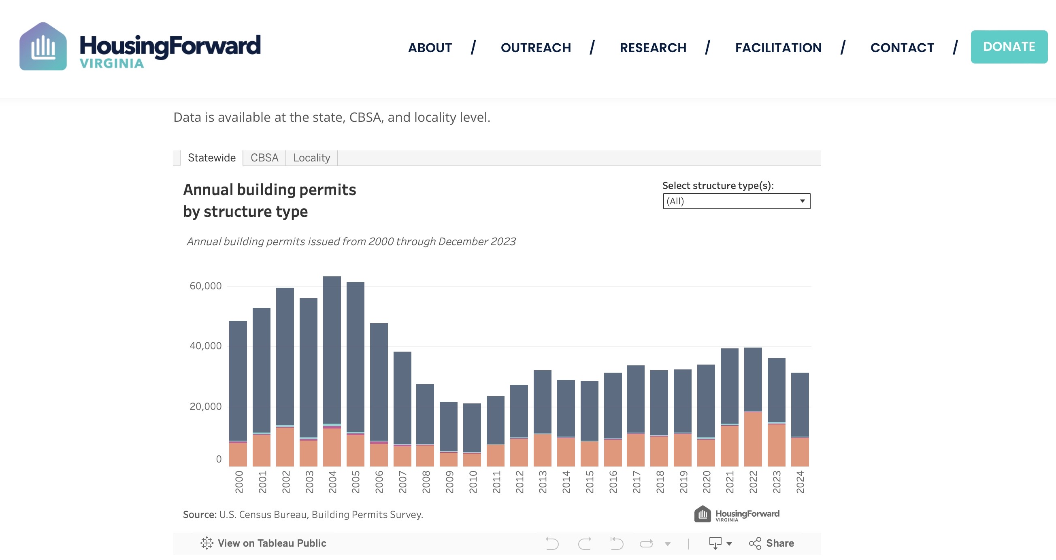
How did we get here?

Slide 12
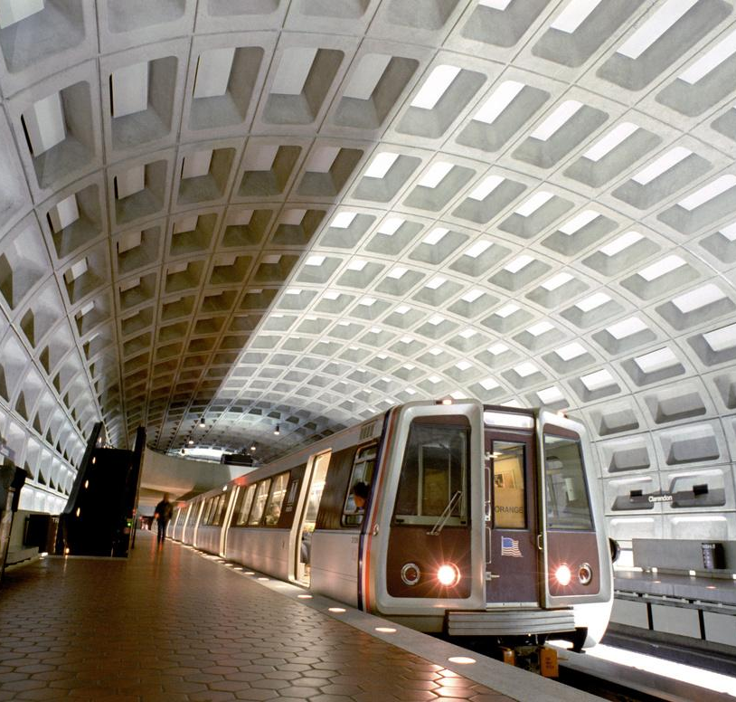



HOUSING IS A REGIONAL ISSUE THAT CALLS FOR REGIONAL SOLUTIONS
Policy solutions acknowledged as best practices:
Housing needs assessment to develop an affordable housing master plan;
Create a dedicated local housing trust fund;
Utilize density to incentivize affordable units;
Prioritize transit-oriented development (TOD); create mixed-income, mixed use communities;
Coordinate land use and transportation planning;
Identify vacant or under-utilized public land to co-locate housing with public facilities;
Green tape development and permitting approval process;
Adopt strategies that preserve affordability and avoid displacement
TOD
Mixed-Use
Green Tape
Density

Slide 13
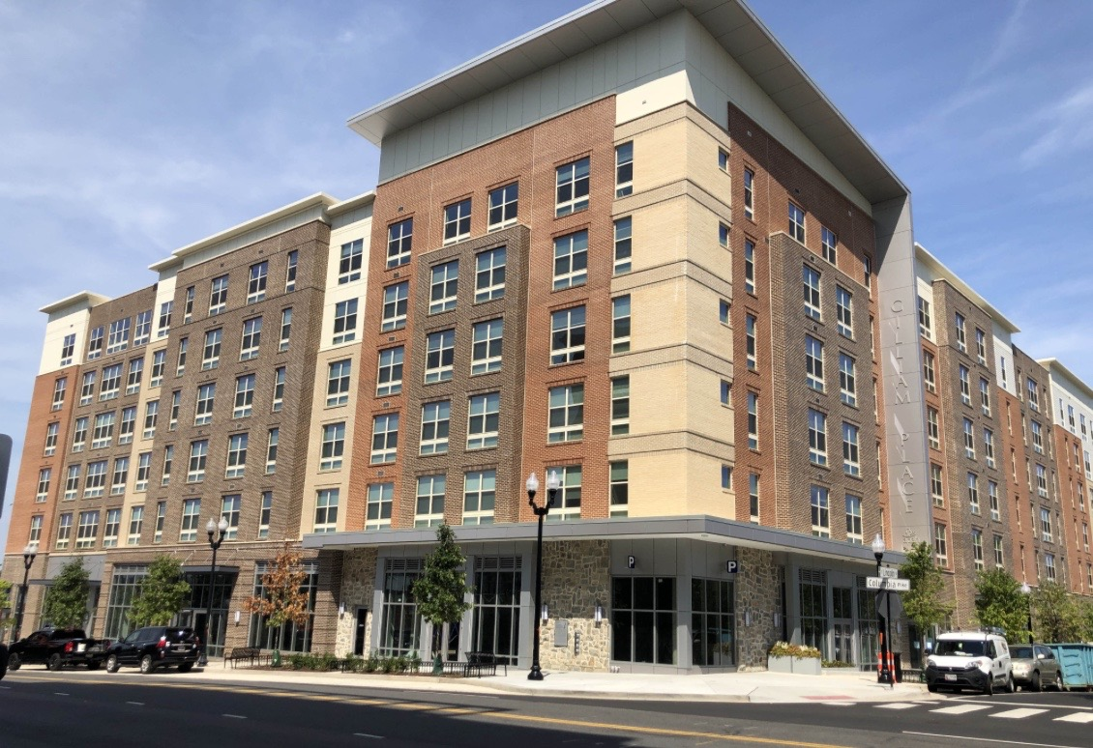
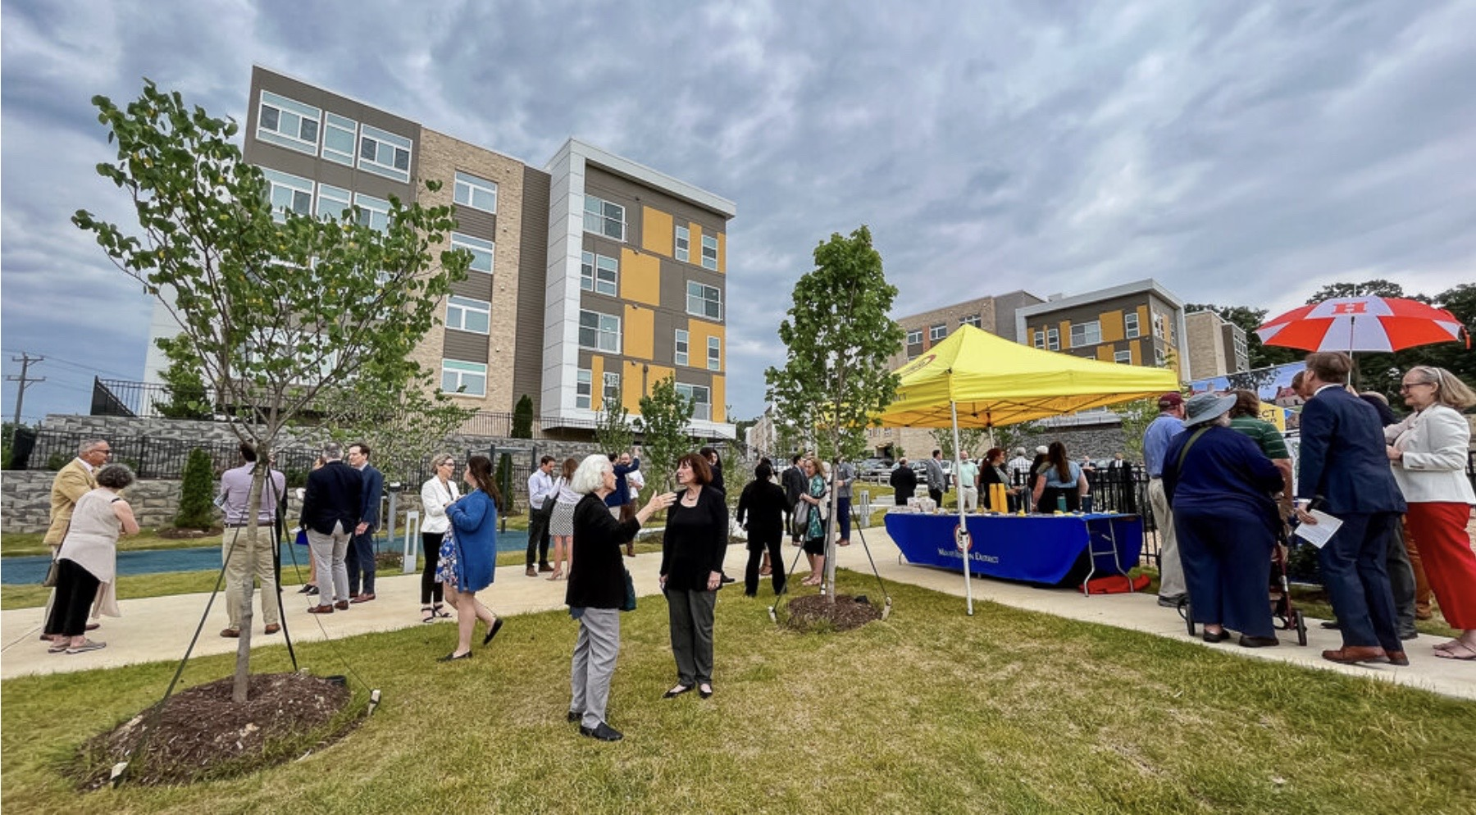
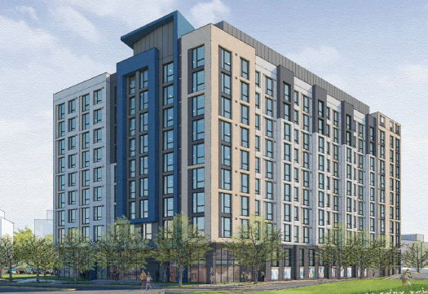
Best Practices
Co-locating Affordable Housing with Community Facilities on PUBLIC LAND or with FAITH COMMUNITIES
Gilliam Place, Arlington
Dominion Square, Tysons
Residences at North Hills, Alexandria

Slide 14








GOVERNMENT CAN'T DO IT ALONE
Private sectors partners should invest in the community
Housing for the workforce
Housing is infrastructure
Housing is inextricably connected to economic development and resiliency
Community Partners
(below market loans, grants or land)
Corporate Partners - Amazon | Washington Housing Initiative (JBG SMITH)
Healthcare institutions - Kaiser Permanente & CVS
Community Foundations - Local, Meyer, Cafritz, VFN
Higher Education – George Mason & Howard University
Houses of Worship - Faith Communities using land for AH

Slide 15
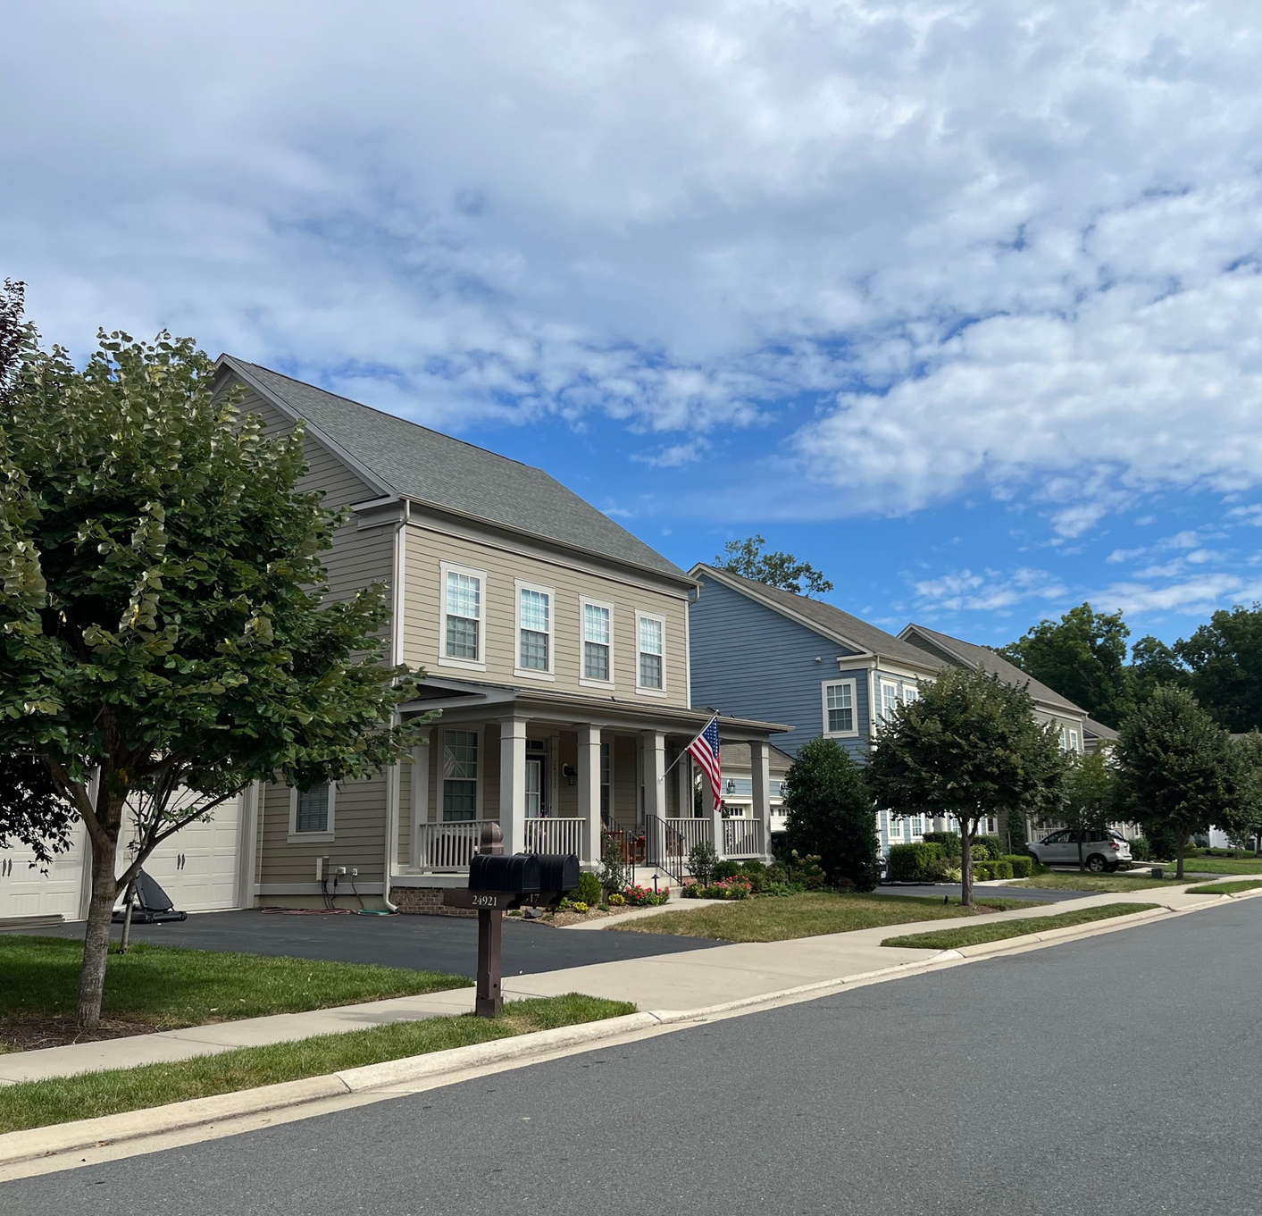

Case Study

Slide 16





Who is Workforce Housing Now?
Additional Funders:
Additional Partners:
Affordable housing developers
Loudoun Chamber of Commerce
Community organizations
Statewide housing experts and consultants

Slide 17
Campaign Objectives
Put a face on the issue of workforce housing to help illustrate the immediate and growing need in Loudoun County
(storytelling)
Advocate for more workforce housing solutions with decision makers and provide voter education on the issue (support strategies in Loudoun County’s Unmet Housing Needs Strategic Plan)
(policy and education)
Ensure more voices and perspectives are heard, to counter NIMBYism (narrative change)

Slide 18

Three Pillars of Workforce Housing Now
1 . Public Awareness Campaign
2. Grantmaking to Support Workforce Housing Production
3. Convening Stakeholders and Advocacy

Slide 19
Phase 1: Public Awareness Campaign and Convening
Workforce Housing Now website
Social media ad campaign with testimonials from community members
Public opinion polls
Print ad campaign
Monthly op-eds in Loudoun Now in Year 1
Workforce Housing Now Advisory Committee of stakeholders

Slide 20
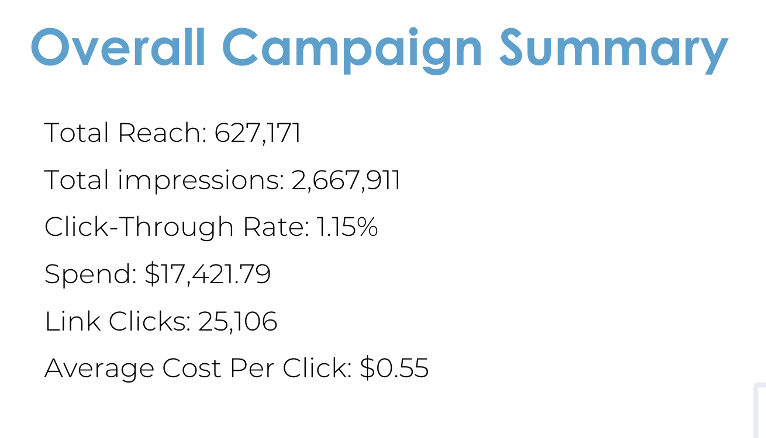
Social Media Campaign – Loud & Clear Marketing

Slide 21


Slide 22
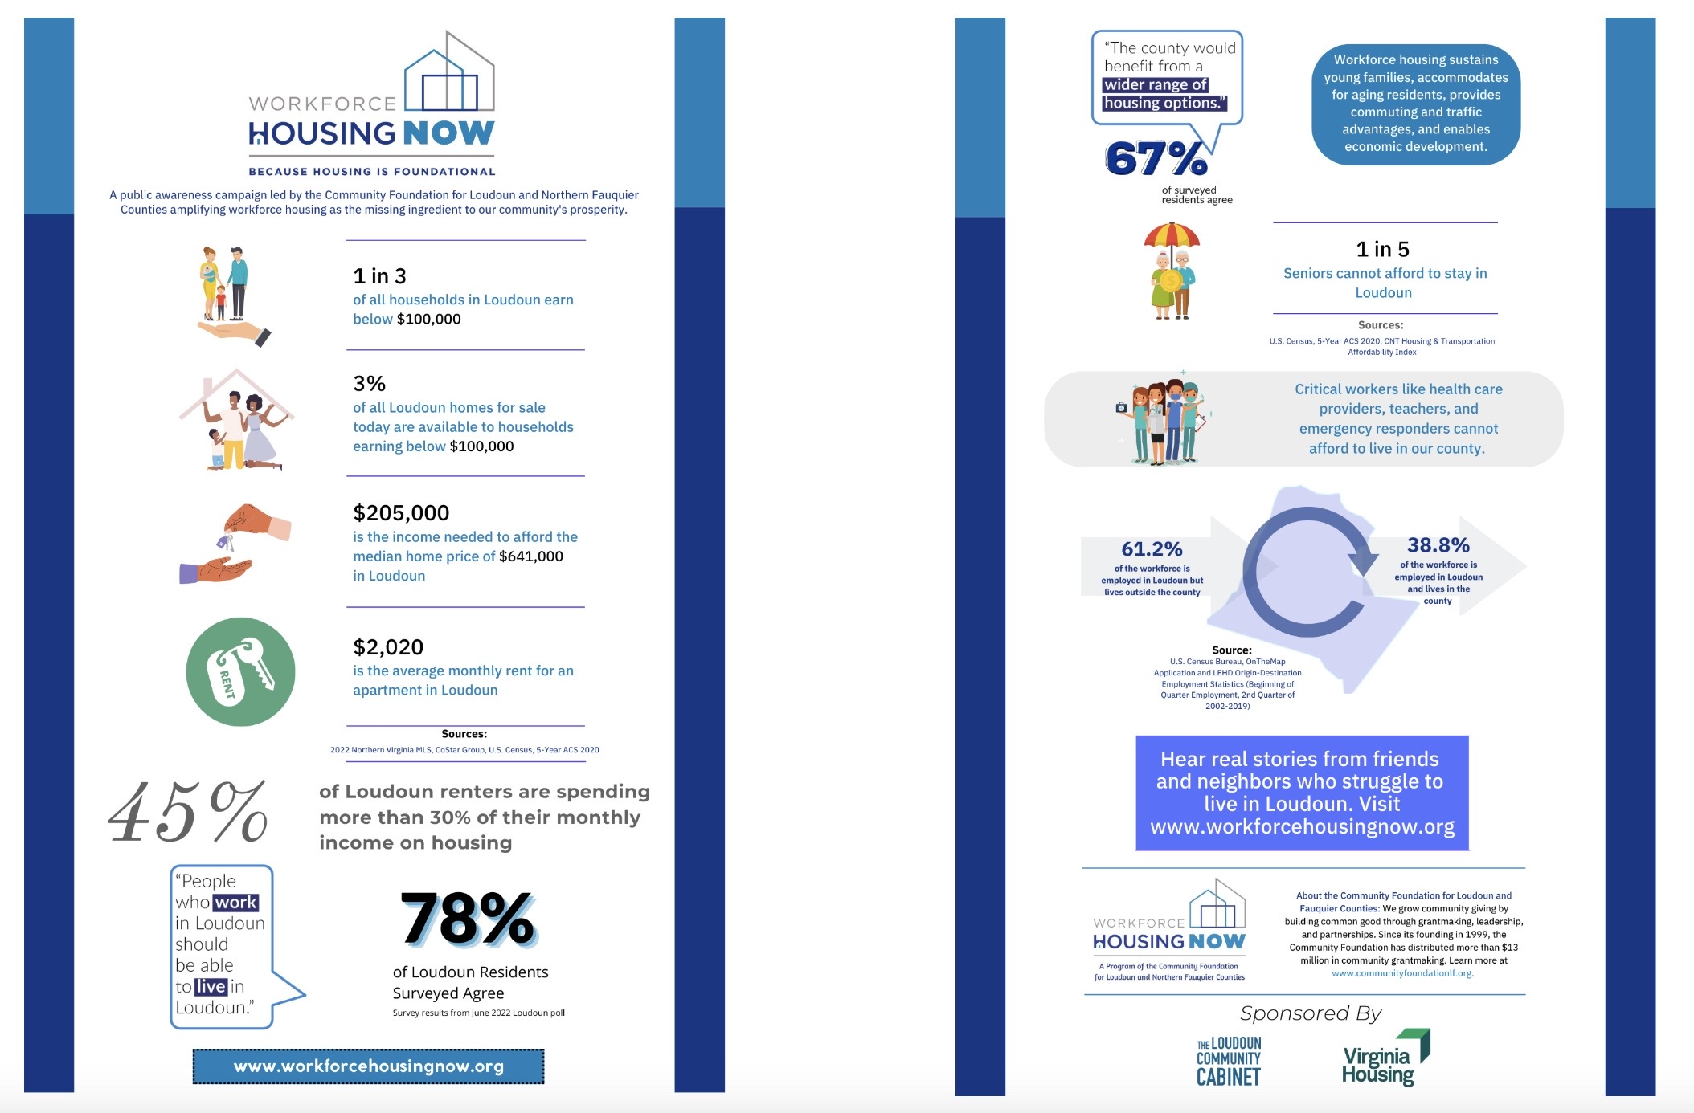

Slide 23
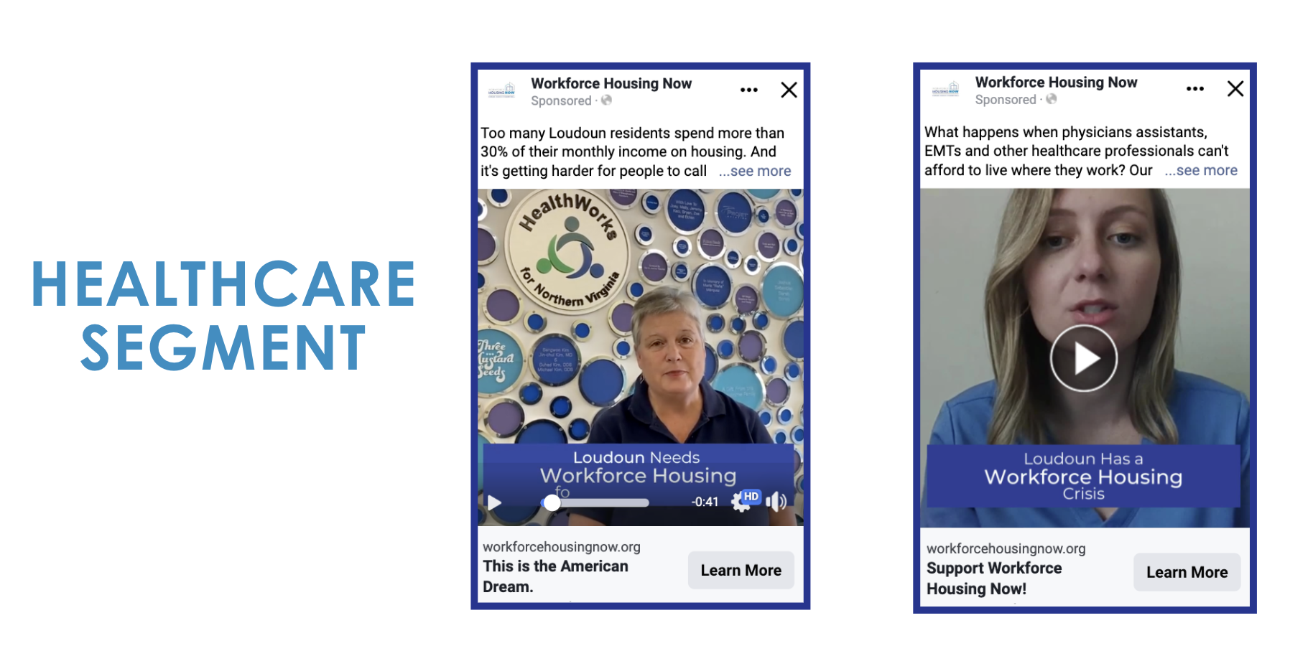

Slide 24
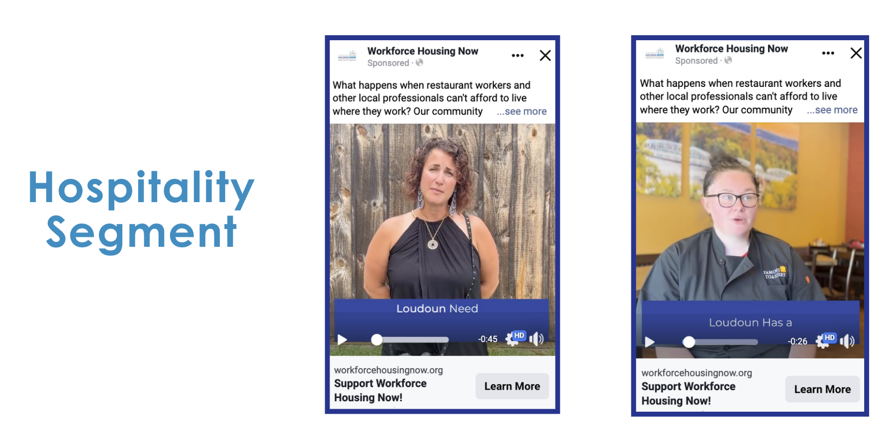

Slide 25
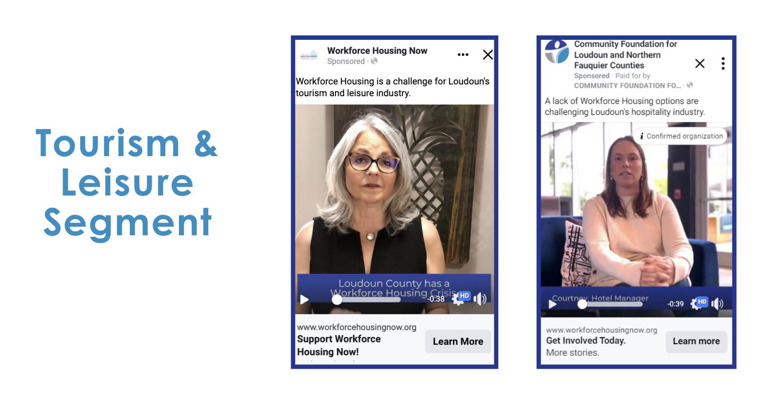

Slide 26


Slide 27
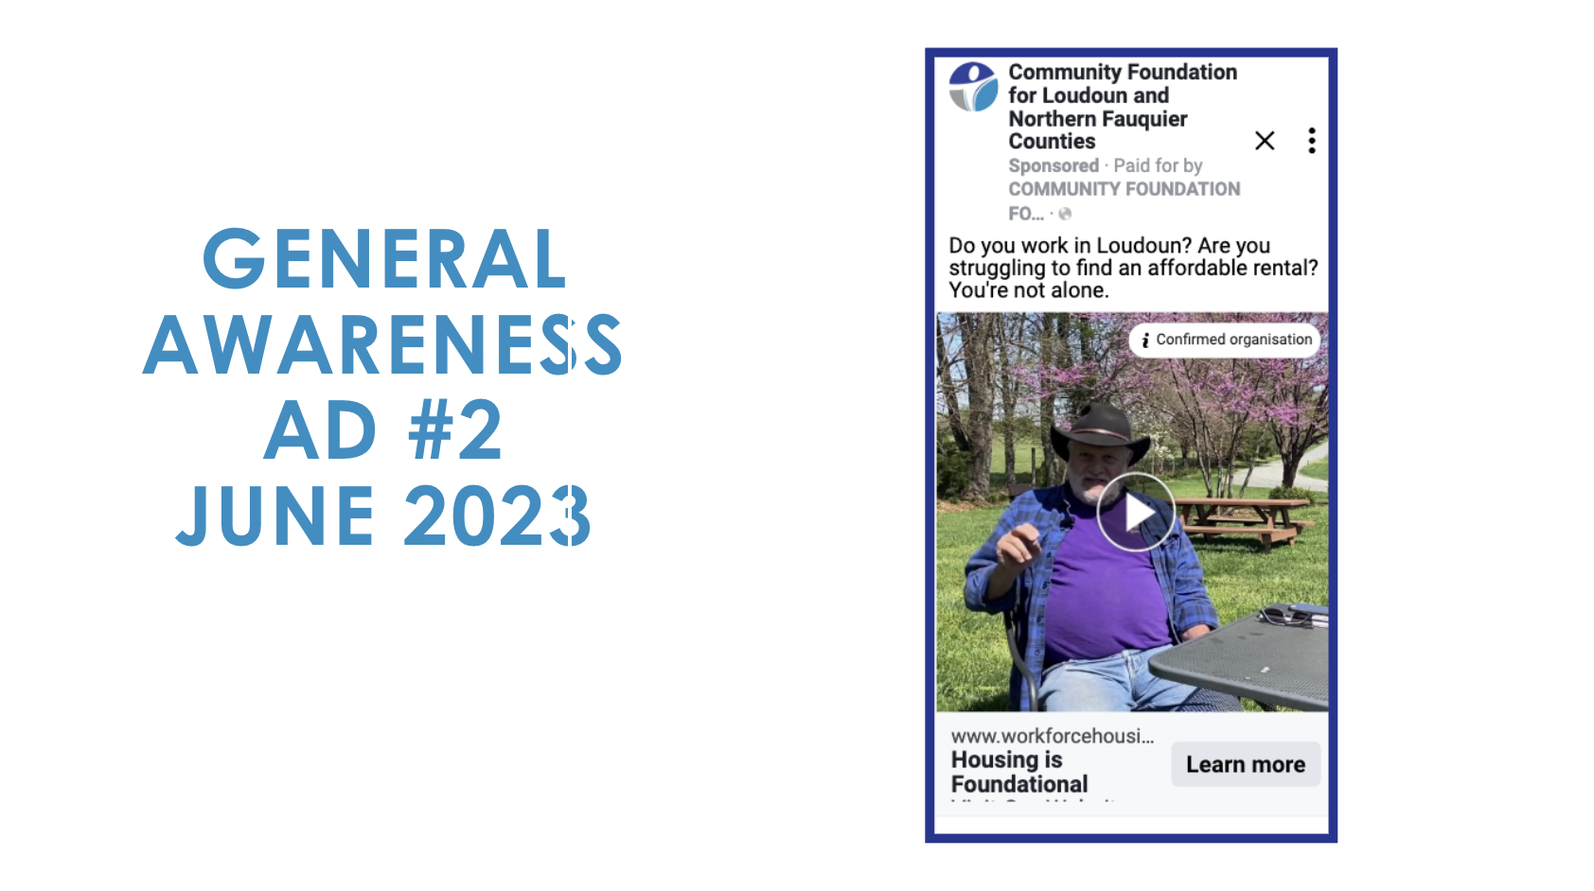

Slide 28
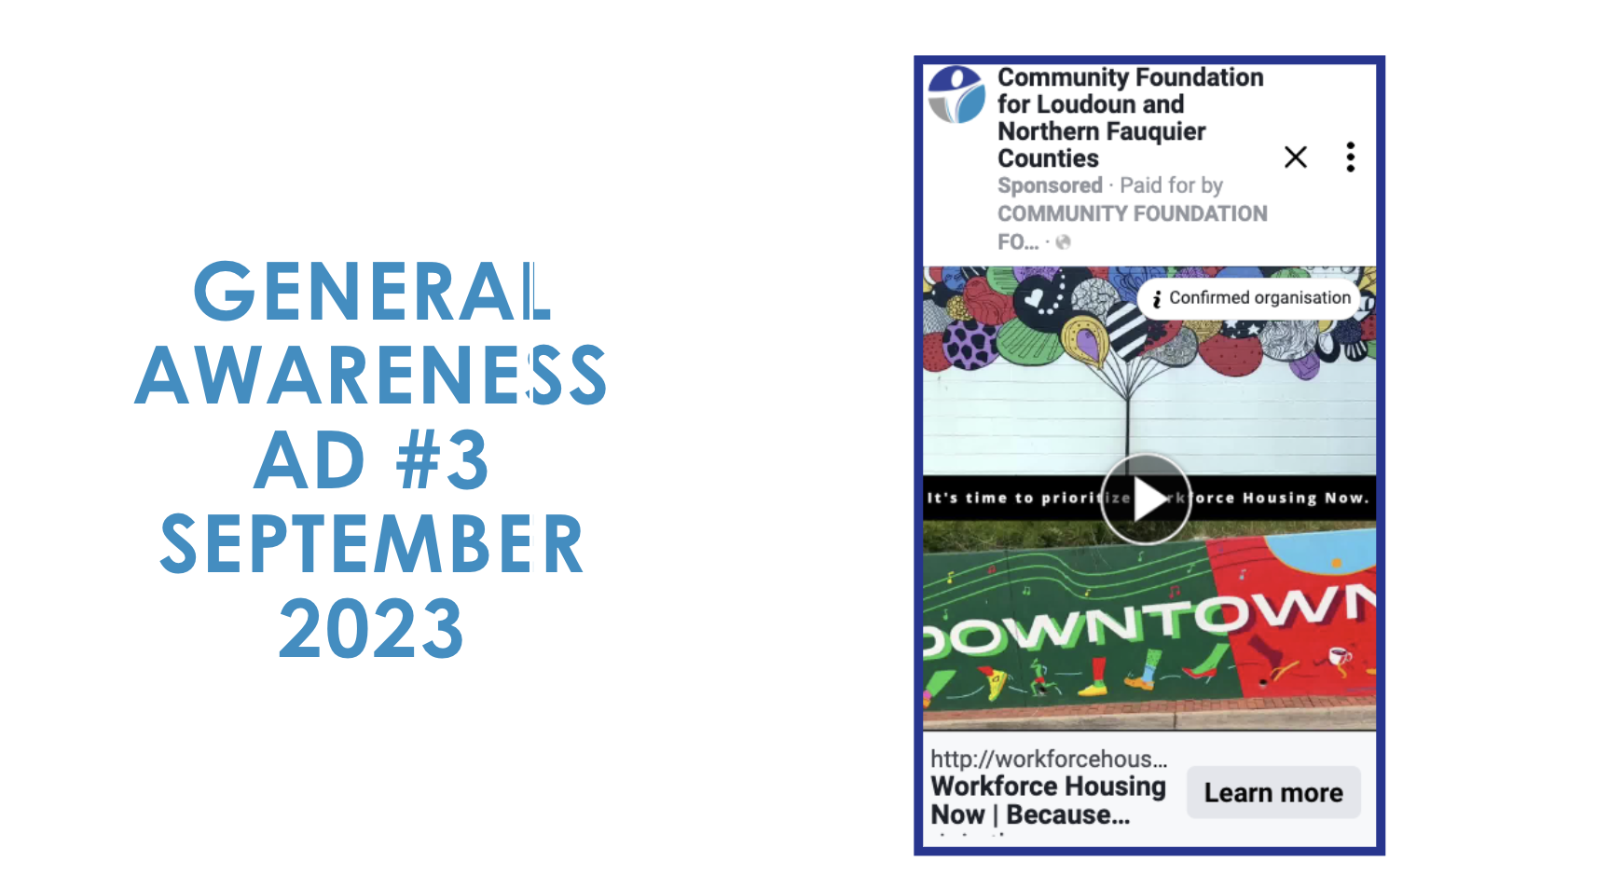

Slide 29
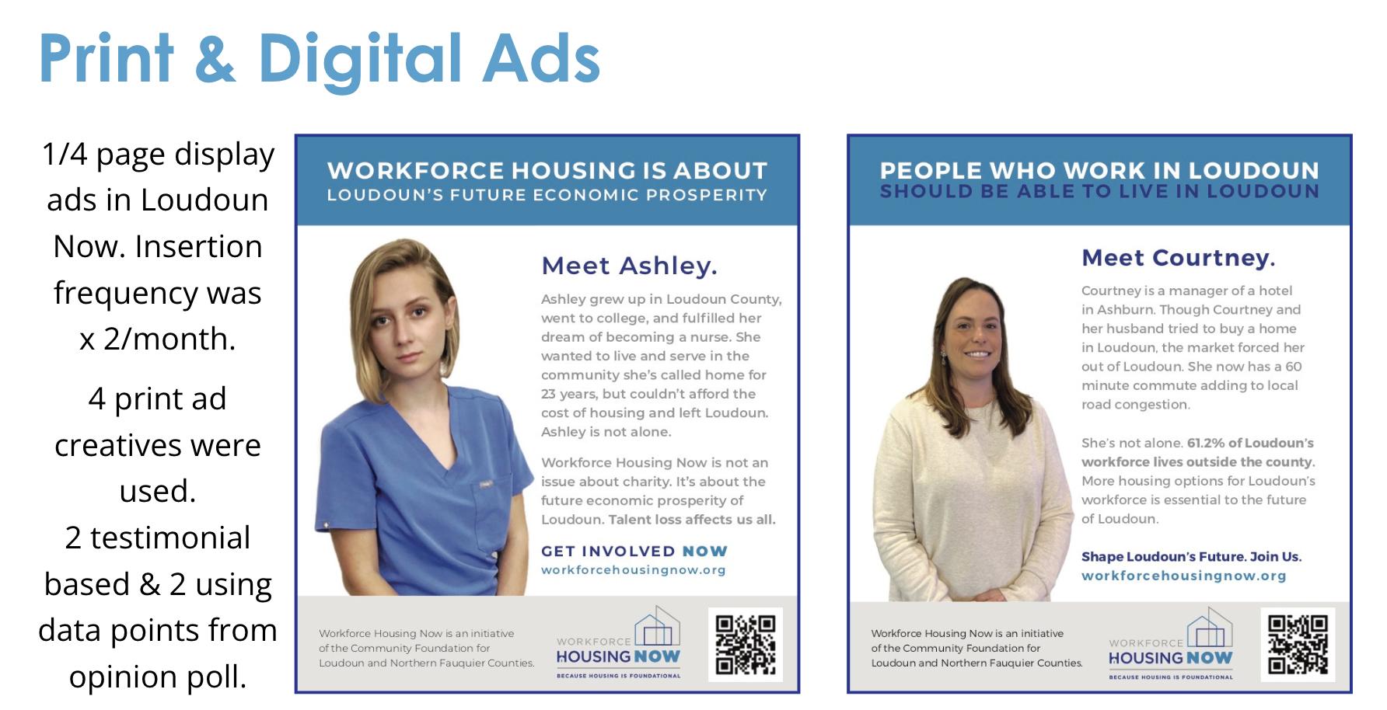

Slide 30
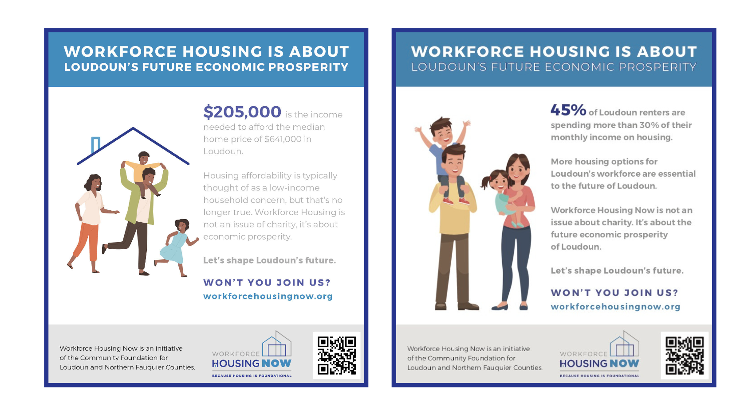

Slide 31
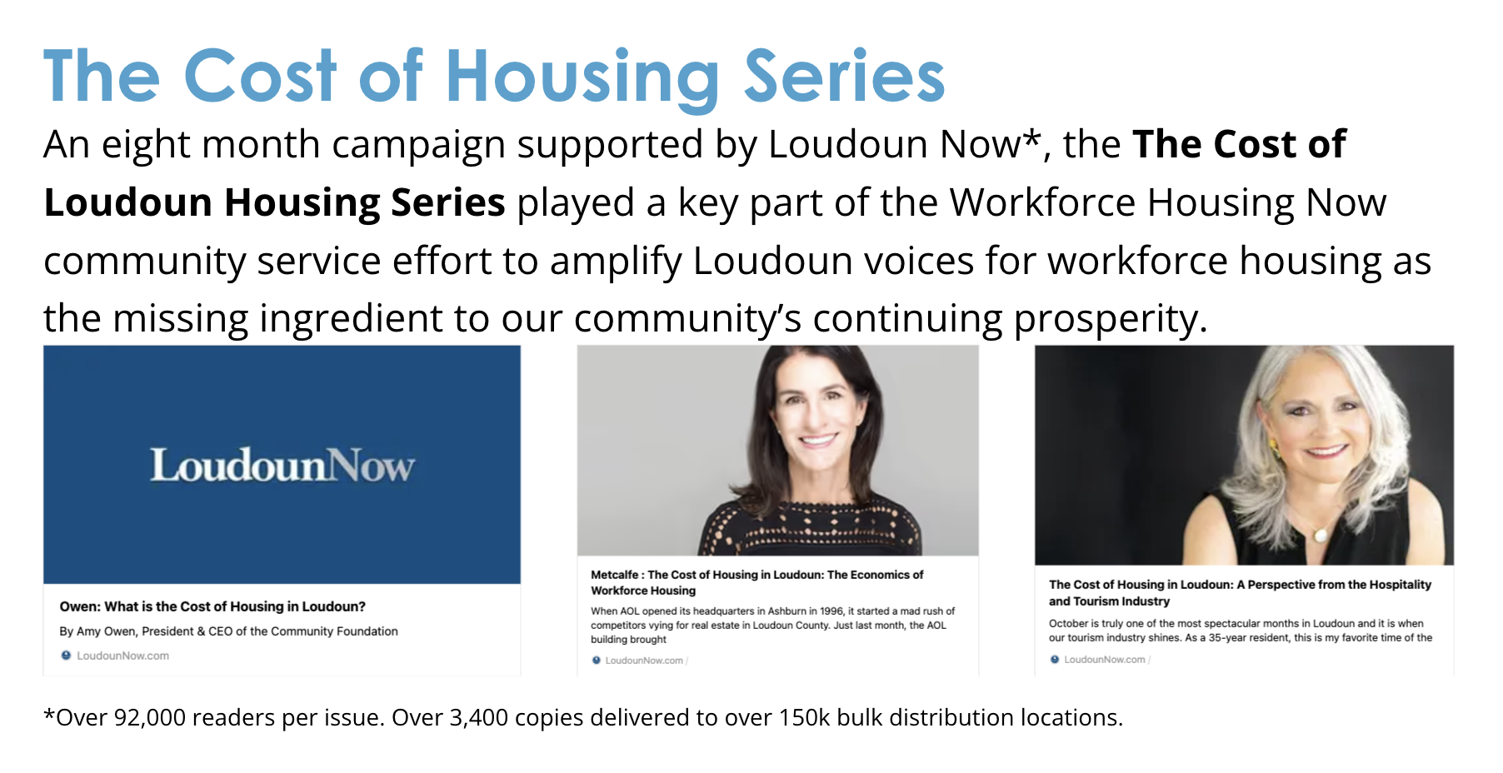

Slide 32


Slide 33
Workforce Housing Now Advisory Committee (15 – 25 attendees on average)
Housing Trust Funds
Effective Housing Advocacy
Missing Middle Arlington Campaign
Module Housing
Housing and the Faith Community
Virginia Legislative Issues
Accessory Dwelling Units
Virginia Zoning Atlas
Northern Virginia Conservation Trust
Current Programs – Loudoun Department of Housing and Community Development

Slide 34
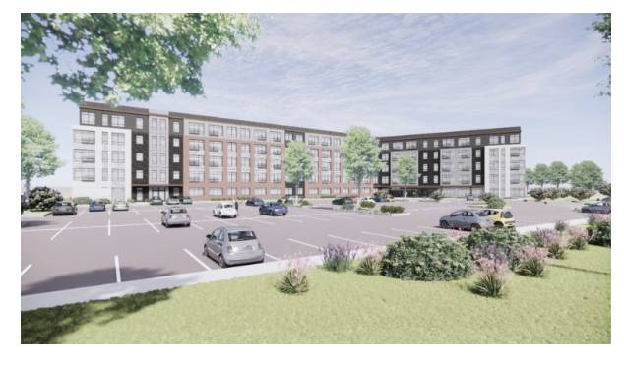

Phase 2:
Grantmaking to Support Workforce Housing Production
Our fund Loudoun Community Cabinet issued RFP to support a nonprofit affordable housing project
Awarded a $350,000 grant to True Ground Housing Partners in October 2022
Support for predevelopment costs for Phase 1 for production of 130 affordable housing units for seniors in Chantilly (Avonlea)

Slide 35
Phase 3: Convening and Advocacy
Public Awareness → Policy and Advocacy
Partnership with Northern Virginia Affordable Housing Alliance (July 2024)
$50,000 grant to NVAHA for new position to create Loudoun advocacy local alliance. Grant renewed.
New position to focus on advocacy and policy

Slide 36
Policy Progress
Zoning Ordinance Rewrite – Chapter 9 on Attainable Housing – December 2023
Housing Fund allocation –additional ½ penny from FY 24 Fund Balance – April 2024 (equivalent of another $7M)
Fast-tracking Affordable Housing Applications pilot – April 2024
Loudoun Housing Advisory Board – re-energized
Improved relationships with Loudoun DHCD Staff - New Director – monthly meetings

Slide 37
Campaign
Consultants to Determine the Issue
Loud & Clear Marketing
Campaign alone was about $225,000 for the 2 years 2022- 2023.
80% of that was on the marketing consultants and housing consultants
20% was spent on advertising costs social media and s=local newspapers
**Can do this for less**
Grantmaking to Support Workforce Housing Production
$350,000 grant to Arlington Partnership for Affordable Housing in October 2022 (application process)
Support for predevelopment costs for Phase 1 for production of 130 affordable housing units for seniors in Chantilly (Avonlea)
Support of NVAHA
$100,000 for two years

Slide 38


Q & A and Invitation to Keep in Touch

